Slide 1
THE REDESIGN OF
Operator’s Manual and Training Materials

Slide 2
THE GOAL
To standardize and improve the overall quality of the cryotherapy treatment and service given by CryoSpace Operator’s worldwide.
METHOD
By understanding the physiological effects of crypotherapy
By understanding the unique aspects of Cryotherapy by CryoSpace
By understandig all safety measures and risks of Cryotherapy
By standardizing the service procedures accordingly

Slide 3
CRYOTHERAPY BY CRYOSPACE
General Information

Slide 4
CRYOTHERAPY
Whole Body Cryotherapy is "accelerated cooling" of the body for therapeutic purposes. During the treatment, the cabin will be cooled to a maximum of -194˚ Celsius for a maximum duration of 3 minutes.
THERAPEUTIC PURPOSES
To improve the blood circulation with enriched and healthy blood and to stimulate the hormonal production. As a result you can experience accelerated recovery, pain and stress relief, weight loss, and an improved overall well-being.

Slide 5
HOW DOES CRYOTHERAPY WORK?
During the treatment the brain registers the increasing cold on its skin. As a result, the body will draw all the warm blood out of its limbs to the upper body in order to protect the vital organs from “freezing”. The veins to-and-from the limbs will contract (vasoconstriction) to ensure that the warm blood stays in the upper body.
The accelerated blood circulation in the upper body creates enriched blood (red and white blood cells, antioxidants, oxygen etc.). During this process your brains come to action, they produce endorphins and noradrenaline to increase your pain threshold and your concentration respectively.
After 3 minutes you step out of the cabin back into the warmth. The brain registers the warmth and lets the blood rush back into your limbs (vasodilation). The accelerated blood flow reaches tendons and bones that would otherwise not be reached. The enriched blood stimulates faster recovery, anti-swelling and anti-inflammatory effect. Pain is relieved due to the endorphins boost.
Keeping your body warm during the treatment costs energy and in addition can speed up your metabolism for up to 8 hours post treatment. The additional energy consumption corresponds to approximately 30-45 minutes of exercise. The cold on your stomach also affects your fat layer; slowly turning white fat into brown fat. Unlike the white fat, brown fat can be utilized by the body as an energy source during exercise.
Endorphin is the fastest working anti-stress hormone and provides release of several (happy) hormones that, among other things, improve your happiness, energy and insulin. The result also includes reduced allergic reactions and food hypersensitivity.

Slide 6
WHY CRYOTHERAPY?
The introduction of cryotherapy has not only paid off in the sports world but has also contributed to successful results in the treatment of a number of lifestyle diseases in the field of biomedical applications. Examples are stress, rheumatic diseases, (over) fatigue, depression, inflammation, diabetes, and obesity. Let us specify further below.
Mood enhancement, deep relaxation, peaceful feeling An important, and often underestimated, phenomenon is that the hormonal effects of cryotherapy cause significant sleep improvements. Because the hormone management system responds to cryogenic temperatures, the release of especially endorphin has a positive influence on perception and state of mind.
Analgesic and swelling reducing It is, for example known that cryotherapy has a pain-killing effect. Cryotherapy is also known to reduce swelling. A consequence of these effects is that it improves the mobility of people who suffer from pain and swelling. Cryotherapy is therefore often used for people with rheumatic diseases.
Preparation to withstand higher loads during exercise Immediately after exposure to low temperatures, blood vessel / capillary dilatation takes place, which increases blood flow together with oxygen and nutrients in the body. Consequently, the elimination of metabolic waste is accelerated. The anti-inflammatory, anti-swelling and analgesic effects help to eliminate the results of the overload of the workout.
Decrease in heart rate It has also been shown that regular cryotherapy, as well as prolonged exercise, lowered the heart rate controlled by the sympathetic nervous system.

Slide 7
WHY CRYOTHERAPY?
Faster recovery Regarding recovery, Cryotherapy is an essential component but also in the clearance of damaged muscle fibers, which are caused after intensive exercise.
Decrease in muscle tension The application of cryogenic temperatures to the muscular system causes a gradual decrease in the temperature of the skeletal muscles and at the same time reduces blood flow through the capillaries. This creates a calming effect at the same time.
Weight reduction Another important factor where Cryo stimulation can play an additional role is the boost of metabolism. Short exposure to extremely cold temperatures on a regular basis can stimulate heat production, that is, create an increased metabolism, which has a beneficial effect on weight loss.
Anti-inflammatory Cryotherapy has a strong antioxidant and anti-inflammatory effect. For that reason, there are also indications that Cryo can be useful in fibromyalgia.
Improvement of skin quality, contribution to cell repair, lasting effect Dermatologically, the low temperatures have an improvement on skin quality. The numerous skin benefits are, for example, skin softness, acne prevention, and increased collagen production. Cryo temperatures also induce increased blood circulation and an increase in the number of white blood cells, which leads to an improved immune system. The increased blood circulation ensures that the skin is supplied with sufficient oxygen and nutrients, and also to adequately remove toxic substances.

Slide 8
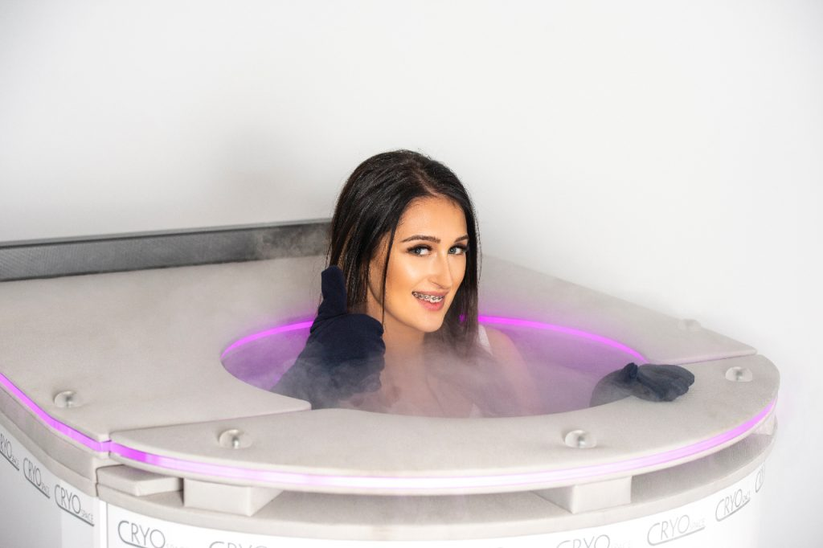
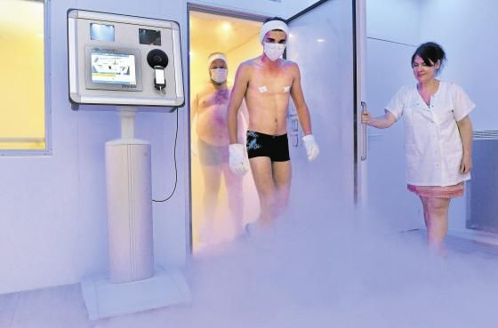
CRYOTHERAPY CLASSIFICATIONS
Cryotherapy Cabine/Chamber
Use of Liquid Nitrogen for treatment
Head and neck free from cold
Temperatures up to -194 °C
Private treatment
Cryotherapy Sauna
Use of electricity for treatment
Entire body and head exposed to cold
Temperatures up to -110 °C (-80°C )
Group treatment

Slide 9
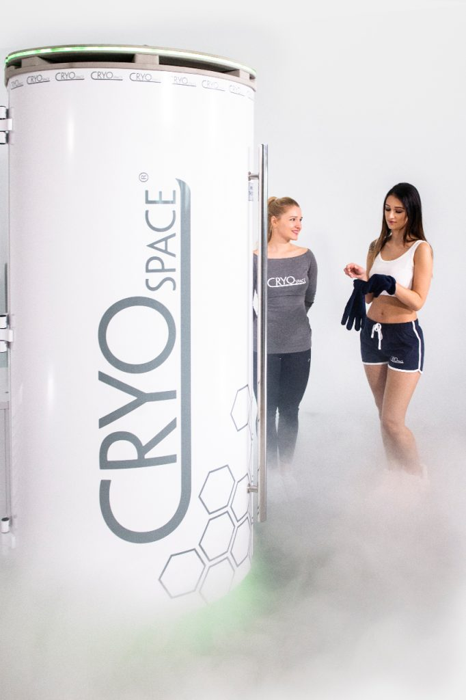
CRYOTHERAPY BY CRYOSPACE
Personal treatment for optimal results With CryoSpace you want to help your customers in the best way possible. You are curious about their problems and their goals and you understand how cryotherapy works. In return, you can provide them with a tailored treatment plan for their needs to get the best results.

Slide 10
CRYOTHERAPY BY CRYOSPACE
Features and Benefits

Slide 11
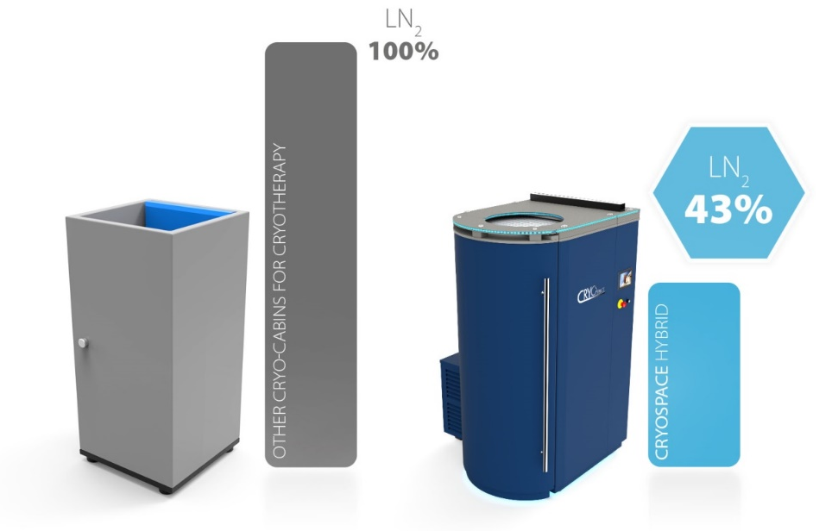
CRYOSPACE FEATURES AND BENEFITS
Most Economical Cryotherapy Chamber
Due to Its unique hybrid system, combining liquid nitrogen (for optimal treatment temperatures) and an electric motor (for pre-cooling and standy-mode), CryoSpace can consume up to 55% liquid nitrogen less compared to other cryotherapy chambers.

Slide 12
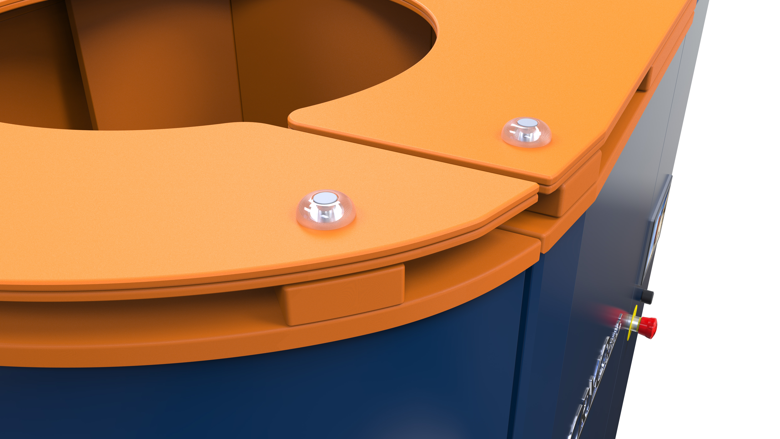
CRYOSPACE FEATURES AND BENEFITS
Safety First CryoSpace offers several standard features to ensure the safety of the user at all times. Such features include:
Flange allowing to for the liquid nitrogen vapor to be directed away from the user inside the chamber during treatment
Automatic ventilation / quick exhaust of the liquid nitrogen vapor from the chamber when treatment finishes to ensure safe breathing for user when lift lowers down
Door sensor which monitors if the door is properly closed
Emergency stop which initiates the emergency shutdown procedure
Independent oxygen sensor to accurately measure the oxygen level in the room

Slide 13
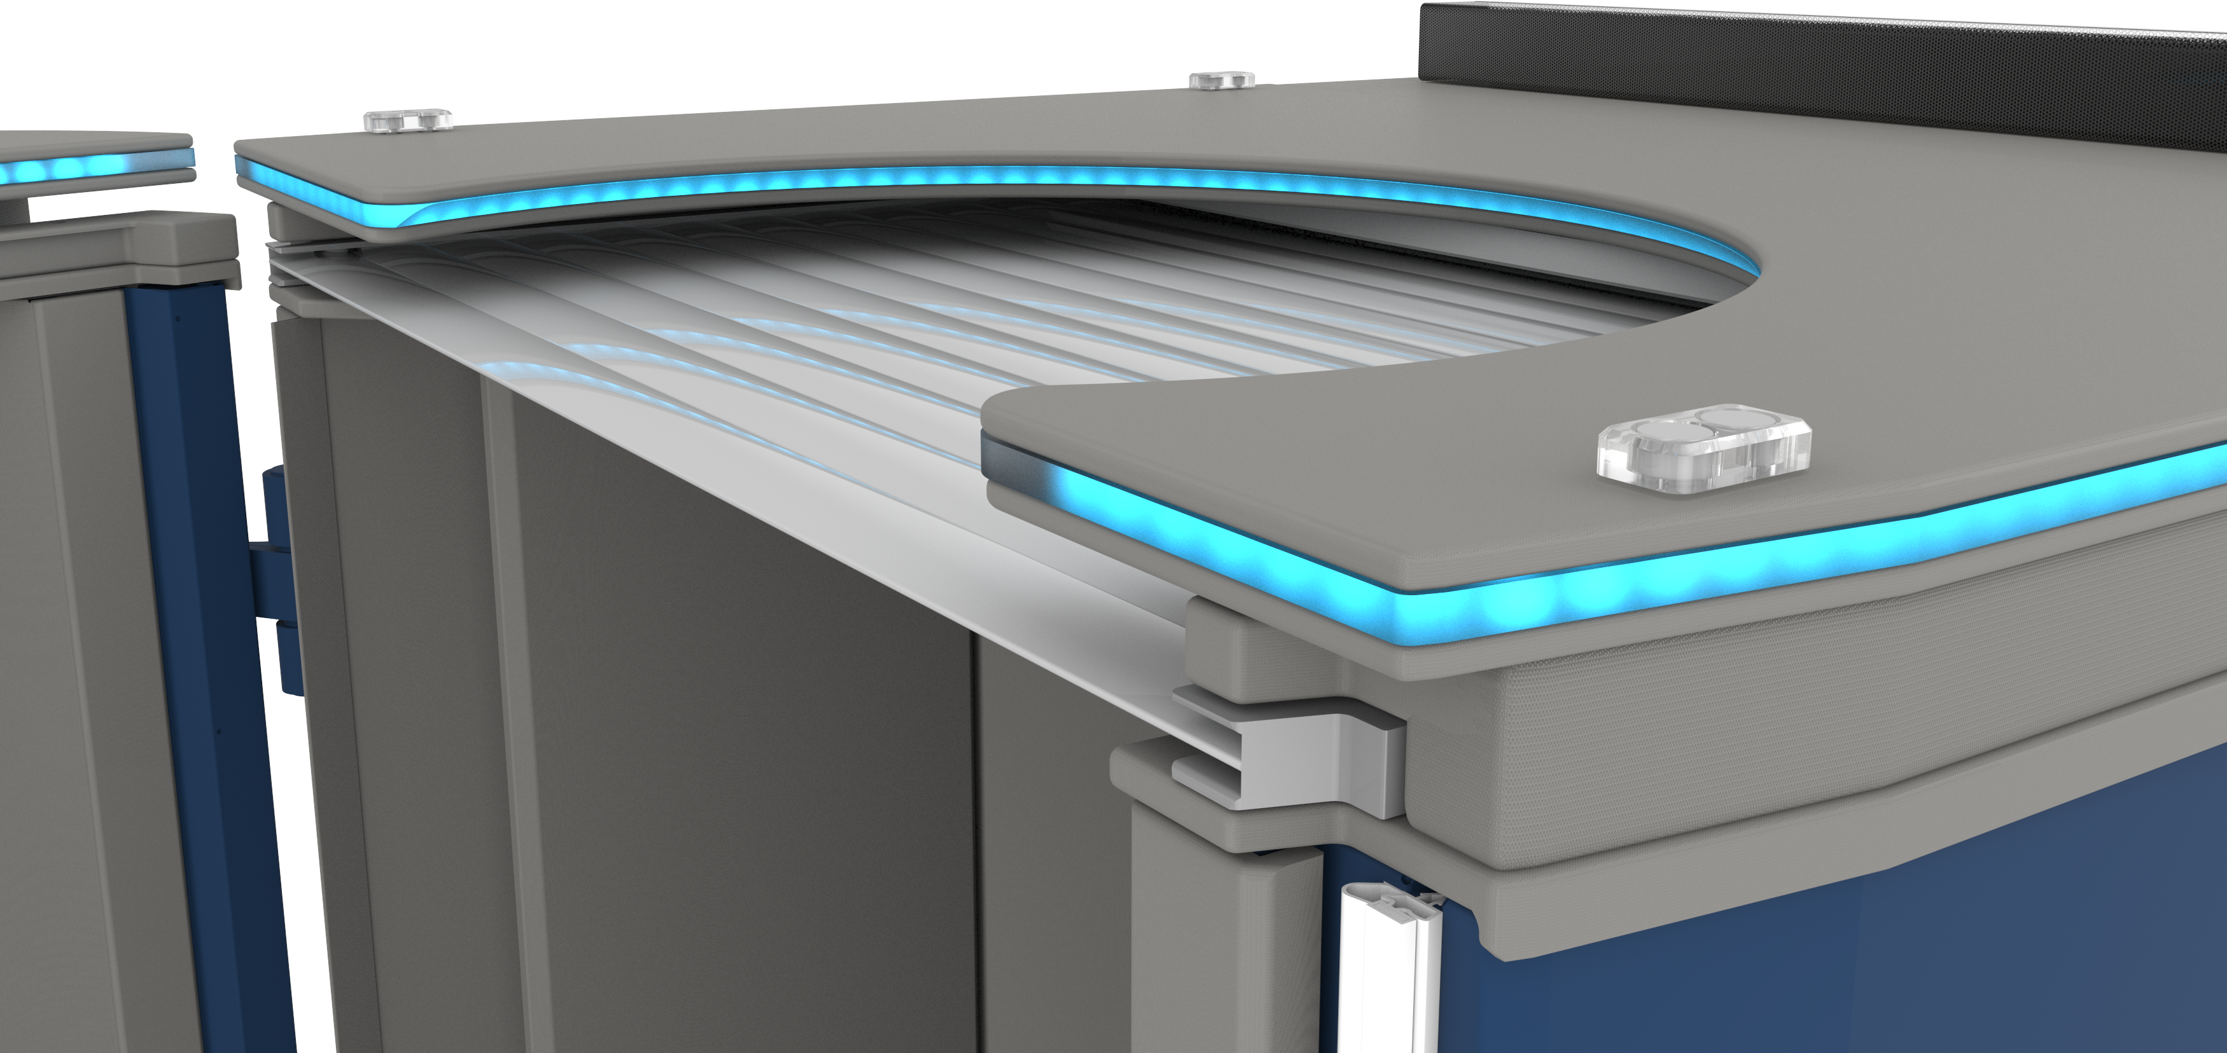
CRYOSPACE FEATURES AND BENEFITS
Designed to keep it Cool
Your CryoSpace is designed with the main purpose to keep the maximum amount of cold inside the chamber and minimizing any unnecessary wastage.
Certified Cryogenic Materials for minimum wastage while providing durability for long-term use.
Automatic Electric Blind that ensures that the cold stays inside when the chamber is not being used for a treatment. Additionally, it makes pre-cooling and standby-mode run more efficient.

Slide 14
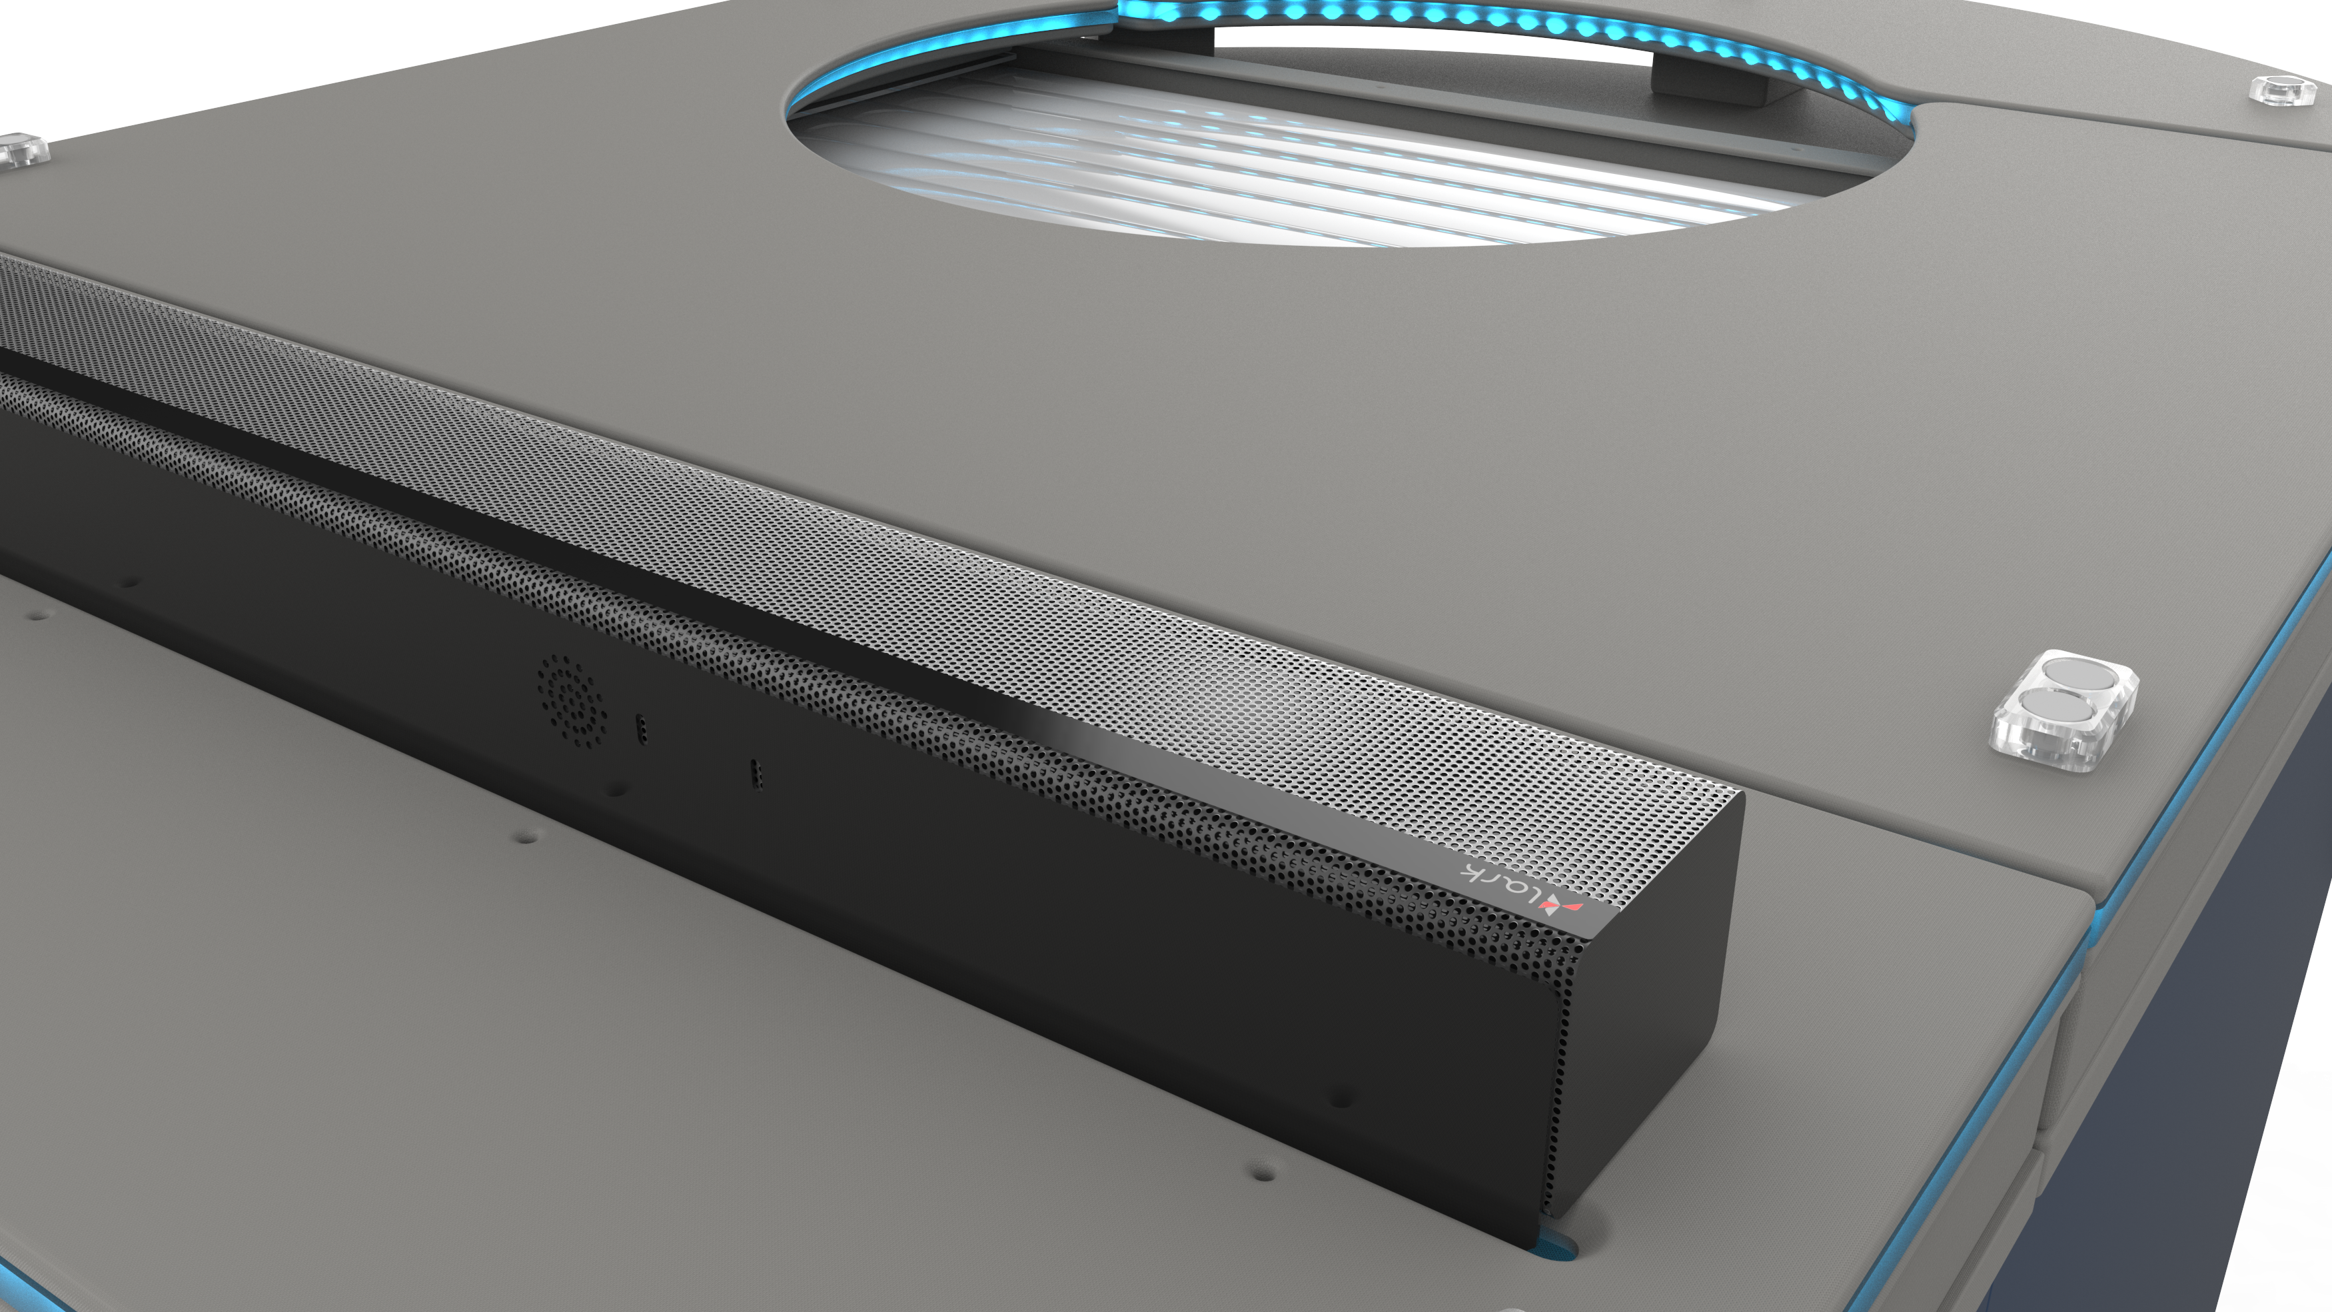
CRYOSPACE FEATURES AND BENEFITS
Branding
Your CryoSpace should be an extension of your brand. Therefore we offer a wide range of standard color options for both the exterior as interior. Additional option include custom colors and logo placement.
Scheduler Automation
Your CryoSpace will cool (and defrost) itself according to an automated schedule making it ready to use when you open your salon.
Additional Options
Built-in Soundbar
LED-lighting / colortherapy (in correspodence with treatments)
Custom color and logo

Slide 15
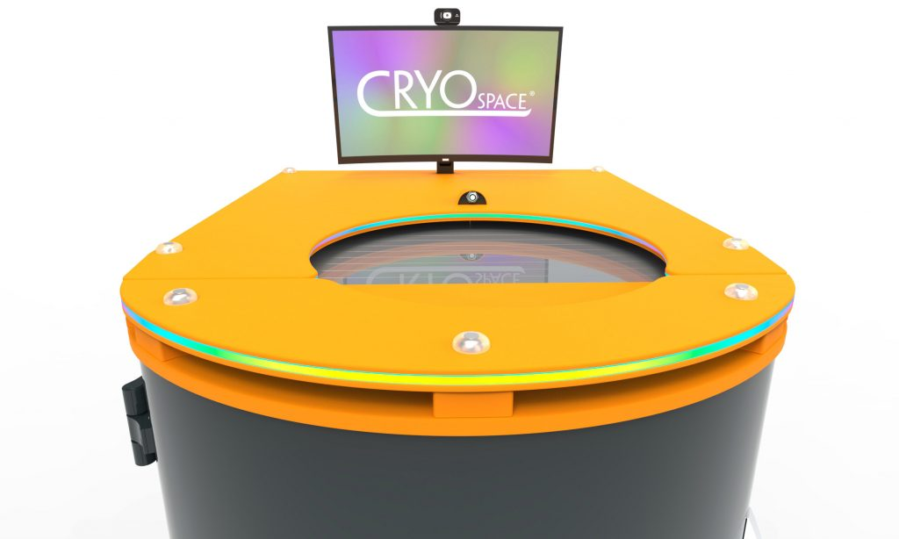
CRYOSPACE PRO – ADDITIONAL BENEFITS
Treatments Based on Medical Research Cryotherapy by CryoSpace gives customers optimal results with a unique system of preprogrammed treatments. Each treatment is based on years of know-how and medical research which determines the intensity, duration and frequency of the treatments based on the desired goal. The three main categories of treatments are (Bio)Medicine, Performance and Wellness.

Slide 16
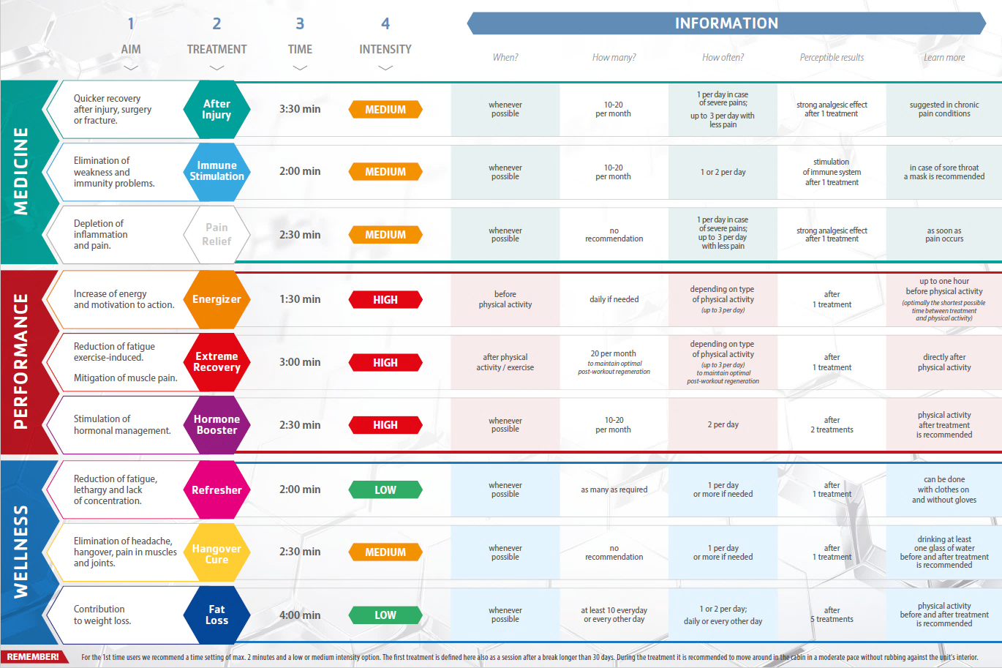

Slide 17
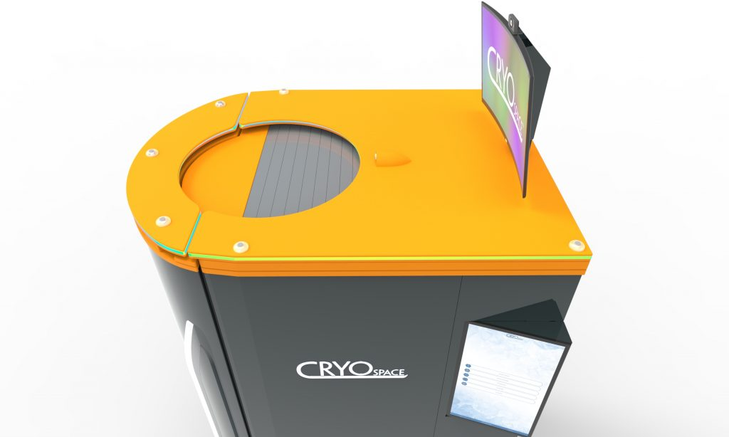
CRYOSPACE PRO – ADDITIONAL BENEFITS
Improved Customer Experience The CryoSpace Hybrid Pro focusses on the experience of your customers:
Digital intake via tablet
Heads up display (27” LCD curved screen) with live session information for customer e.g. live temperature, treatment program, treatment benefits and camera view.
A 23.8” touch panel for operator.
Digital photo of session, automated (also print possibility)
Sessions reports, automated

Slide 18
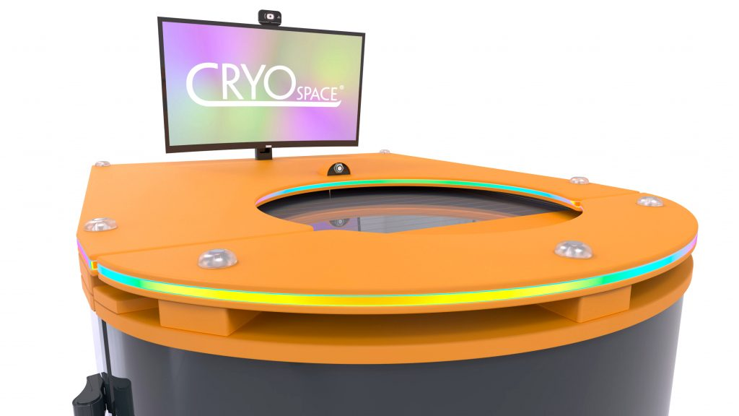
CRYOSPACE PRO – ADDITIONAL BENEFITS
Safety CryoSpace Pro offers an additional presence sensor which monitors the user’s proper positioning during treatment. If a user does not follow the prescribed safety position, then your CryoSpace will activate an alarm followed by emergency shutdown.
Customer Management System Post-treatment report will automatically be sent to your customer via email including the photo made during treatment. System allows for online customer statistics and treatment history, QR code login, printer integration and digital intakes through tablet. Additional integration possibilities with CRM-systems.

Slide 19
CRYOTHERAPY BY CRYOSPACE
Technical Requirements

Slide 20
ROOM INSTALLATION REQUIREMENTS
Minimum height requirement 2,5 m. (2,8 m for Pro)
Minimum dimension door width 80 cm. (This includes all doors that the CryoSpace needs to transport through)
Minimum room temperature 5°C
Maximum room temperature 25°C
Minimum room humidity 15%
Maximum room humidity 60% (non-condensing)
Independent ventilation advised Yes
Ventilation transfer location Directly outside to designated area
Independent ventilation dimensions Minimum channel diameter Ø 100 mm
Power supply 230 VAC/13 A
Number of required sockets 2 (for CryoSpace unit and for Wifi router)
IMPORTANT NOTES
Storage and transportation of liquid nitrogen must be according to the local regulations.
If there is no possibility to connect the chamber directly to the independent ventilation channel:
Keep door to the room or window (slightly) open during treatment.
Independent oxygen sensors are mandatory to ensure the necessary safety.
Keep in mind that CryoSpace emits max. 75 m3/h nitrogen vapour into the installation room.

Slide 21
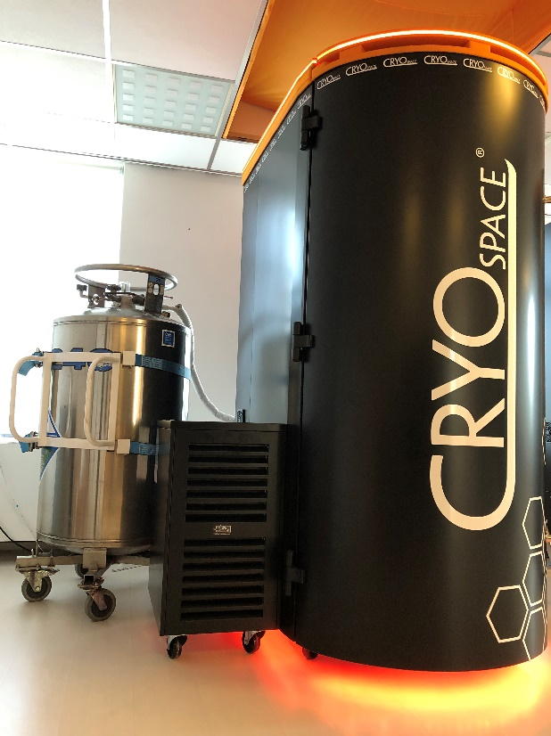
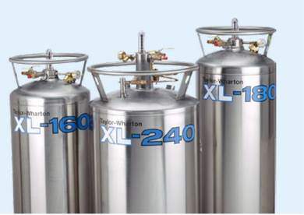
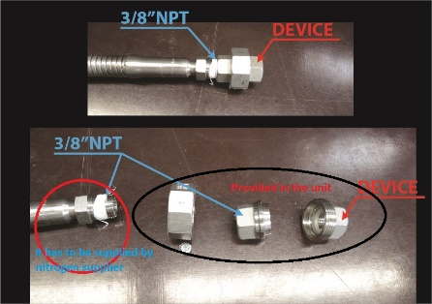
LIQUID NITROGEN CYLINDERS FOR CRYOSPACE PRODUCTS
A Liquid nitrogen cylinder must have pressure builder.
Liquid nitrogen cylinder must have safety valves and manual valve for each device.
Liquid nitrogen cylinder should have pressure valve of around 1,5bar (22PSI) for optimal nitrogen consumption, but not more than 3,5bar (50PSI).
Cylinders must only be destined for the handling of liquid nitrogen.
ADDITIONAL REQUIRED EQUIPMENT
Wheel set for easy transportation of cylinders
Cryogenic gloves
Independent oxygen measuring system
(Isolated) nitrogen hose ending with male thread 3/8’’npt

Slide 22
CRYOTHERAPY BY CRYOSPACE
Procedures and Safety

Slide 23
THE ROLE OF AN OPERATOR
Informing users about cryotherapy the possible risks (contra-indications)
Asking users about their goals
Advising and selling treatments and treatment plans based on their needs
Explaining the treatment procedure
Guiding the user through the treatment (incl. post-treatment)
Safe keeper of the user at all times

Slide 24
POSSIBLE RISKS OF CRYOTHERAPY
As a CryoSpace operator you have to ensure that at all times, the user inside the chamber is safe and feeling well. Below you can find the possible risks you need to take into account when operating CryoSpace.
Not adhering to protocol can result in serious injury
Whether you are helping a customer, colleague or family member, protocol must be followed at all times regarding intake, treatment procedures and post-treatment procedures.
Insufficient Oxygen
Release of nitrogen into the atmosphere of a closed room or incorrect user position inside the chamber may result in the insufficient breathing of oxygen by the user (and operator). This may cause dizziness and can even cause the user to faint with all its consequences.
Contra-indication protocol
User must always begin with an intake where they will have to sign an document stating they do not have any of the contra-indications of cryotherapy. Users with the mentioned diseases / conditions cannot participate in a session until they receive the consent from a medical specialist. Knowingly false statements by users cannot be accepted.
Cryogenic burns
Exessive exposure to extreme temperatures can cause the skin to freeze resulting in (serious) burn marks. This proces can be accelerated by damp/wetness on the skin (i.e. sweat and creams), metal that is in contact with the skin and by open wounds.

Slide 25
ENSURING USER SAFETY AT ALL TIMES
On the following pages you can find the various aspects you need to take into account when operating CryoSpace. All aspects must be communicated to the user and verbally and visually verified before starting a treatment.
Skin Conditions
In order for a user to enter a CryoSpace you must check if their skin:
Is dry (no cream, no sweat etc.)
Is not sticking to metal (e.g. jewelry, piercings, metal clip in bra etc.) Earrings are not a problem.
Has no open wounds, where the blood is visible
Protective clothing
In order for a user to enter a CryoSpace, users are required to wear:
Socks
Thick-sole footwear
Underwear
Gloves

Slide 26
ENSURING USER SAFETY AT ALL TIMES
Proper user position inside chamber
It must be strictly observed that the mouth of the user inside the chamber is at least 10 cm above the flange in the safe breathing zone to ensure proper breathing of the ambient air. Do not start a treatment until the user is in proper position. Furthermore, be aware that when user is talking during the treatment, it can lead to extra risk of breathing excessive liquid nitrogen vapour. Improper user position can lead to a loss of the user's consciousness in mere seconds. In case of doubt, always raise the lift.

Slide 27
GUIDING THE USER
First time Users
First time user require more time, patience and guidance. Cryotherapy is new for them, it is scary and they are insecure if they can withstand the extreme temperatures. To ensure a positive first experience and a secure a second visit, is is therefore important to:
Give Intake
Explain all risks involved with the use of cryotherapy and have customers fill out the digital intake form with contra-indications.
Explain and verify protective clothing and skin conditions
Whether you are helping a customer, colleague or family member, protocol must be followed at all times regarding intake, treatment procedures and post-treatment procedures.
Explain the treatment and how the machine works
Whether you are helping a customer, colleague or family member, protocol must be followed at all times regarding intake, treatment procedures and post-treatment procedures.
Guide them through the treatment
Whether you are helping a customer, colleague or family member, protocol must be followed at all times regarding intake, treatment procedures and post-treatment procedures.
Post-treatment care
Whether you are helping a customer, colleague or family member, protocol must be followed at all times regarding intake, treatment procedures and post-treatment procedures.

Slide 28
POST-TREATMENT
Below you can find the various aspects you need to take into account when operating CryoSpace. All aspects must be communicated to the user and verbally and visually verified before starting a treatment.
Drink water
With CryoSpace you want to help your customers in the best way possible. You are curious about their problems and their goals and you understand how cryotherapy works. In return, you can provide them with a tailored treatment plan for their needs to get the best results.
Explain the possible effects they can experience that day
With CryoSpace you want to help your customers in the best way possible. You are curious about their problems and their goals and you understand how cryotherapy works. In return, you can provide them with a tailored treatment plan for their needs to get the best results.
In case they have difficulty warming up
With CryoSpace you want to help your customers in the best way possible. You are curious about their problems and their goals and you understand how cryotherapy works. In return, you can provide them with a tailored treatment plan for theirneeds to get the best results.
Sell treatment plan
With CryoSpace you want to help your customers in the best way possible. You are curious about their problems and their goals and you understand how cryotherapy works. In return, you can provide them with a tailored treatment plan for theirneeds to get the best results.

Slide 29
EXAMINATION OF CRYOSPACE OPERATORS
ADDITIONAL FOCUS TOWARDS
Cryotherapy classifications
How cryotherapy works
The benefits of cryotherepy
The benefits and features of CryoSpace
Technical room requirements
Liquid nitrogen cylinder requirements
The role of CryoSpace operators
Risks of Cryotherapy
Contra-indications
Safety protocols
Treatment protocols

Slide 30
CRYOTHERAPY BY CRYOSPACE
Our Product Presentation

Slide 31
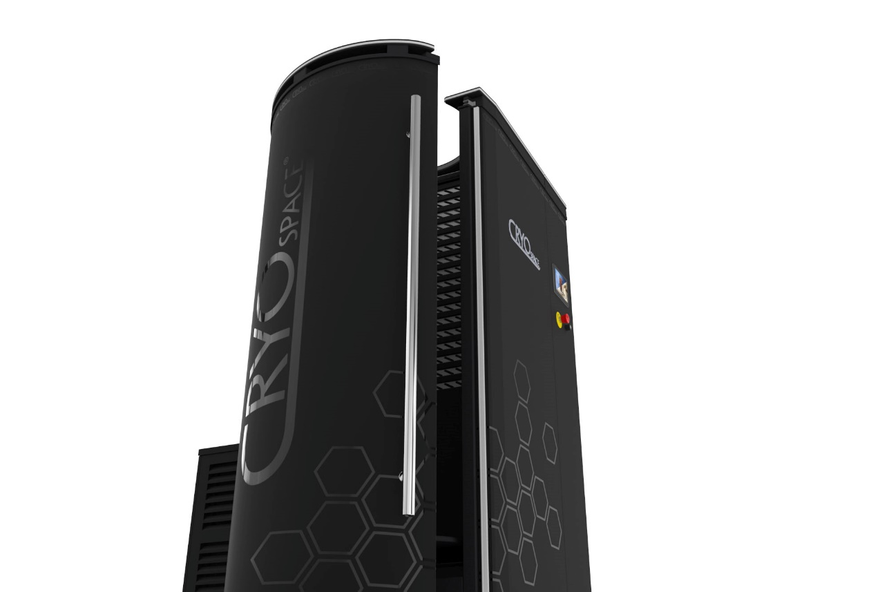
THE COOLEST PLACE ON EARTH

Slide 32
CRYOTHERAPY
Whole Body Cryotherapy is "accelerated cooling" of the body for therapeutic purposes. During the treatment, the cabin will be cooled to a maximum of -180˚ Celsius for a maximum duration of 3 minutes.
THERAPEUTIC PURPOSES
To improve the blood circulation with enriched and healthy blood and to stimulate the hormonal production. As a result you can experience accelerated recovery, pain and stress relief, weight loss, and an improved overall well-being.

Slide 33
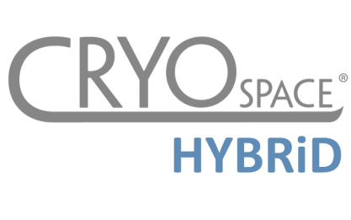
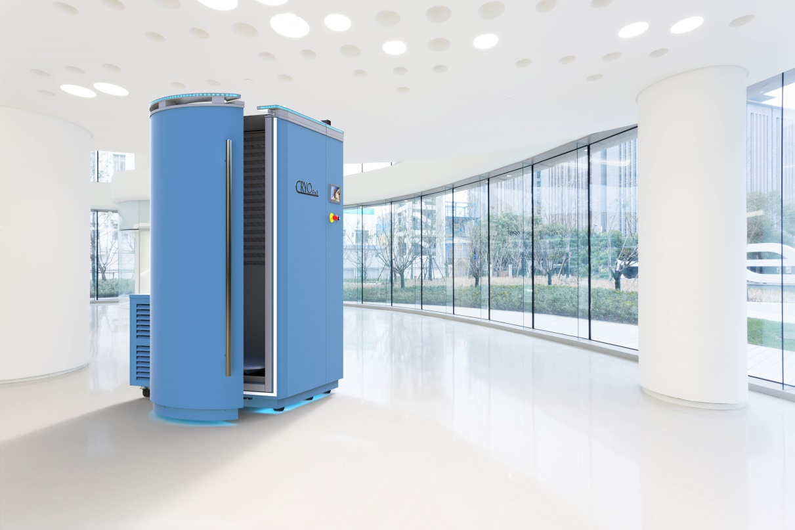
CRYO FOR PERFORMANCE
To increase physical and intellectual performance.
With whole-body cryotherapy, you increase physical and mental performance and simultaneously reduce the risk of injury. Treatment up to three minutes facilitates the following physiological and psychological processes in the body:
Improvement of the cognitive and physiological provision of performance
Accelerates recovery and regeneration processes after overloads and injuries
Facilitates therapies to reduce hypertension in the muscular system
Increases the energy level and improves sleep quality
Pain relief with concomitant anti-inflammatory effect (analgesic effect and anti-swelling effect)
Increase of serum beta-endorphins, noradrenalin, adrenalin and testosterone
Improvement of immune system activity
Can lead to a reduction of performance-related “fear of failure” at the crucial moment
Positive anti-oxidative effect on the whole body, thus preventing over acidification.

Slide 34
CRYO FOR WELLNESS
For a better quality of life.
Treatment up to three minutes facilitates the following physiological and psychological processes in the body:
Positive anti-aging effect through rejuvenation processes and tissue recovery
Increased collagen production for a noticeably smoother and firmer skin
Positive effect on problematic areas (e.g. with cellulite, acne, etc.)
Release of endorphins, mood elevation and anti-stress
Activation of libido
Boosted metabolism
Increase of energy level
Weight reduction through increased caloric requirements
Increase of testosterone level (in men)
Positive impact on mental disorders
Improvement of falling asleep and sleep quality
Improvement of immune system activity

Slide 35
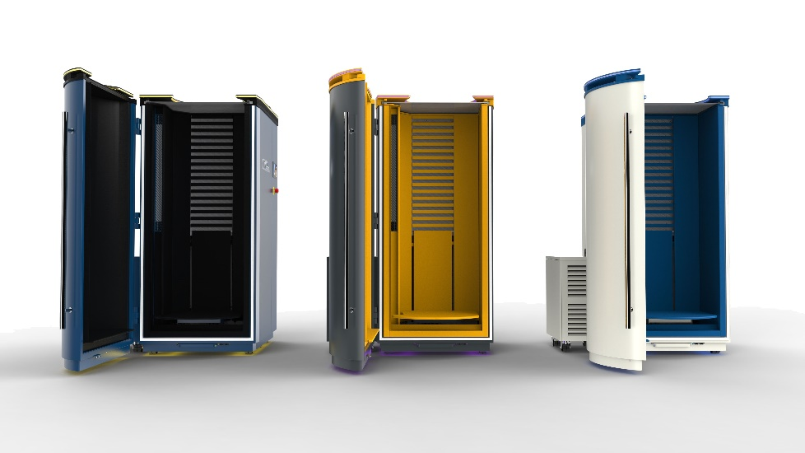
CRYO FOR (BIO)MEDICINE
Accelerates recovery and regeneration process.
Treatment up to three minutes facilitates the following physiological and psychological healing processes in the body:
Pain relief, anti-inflammatory effect and anti-swelling effect
Reduction of cholesterol level (significant reduction of LDL/increase of HDL)
Enhances the effect of many orthopedic therapies (e.g. for rheumatism, back pain, and many more)
Improvement of the immune system
Activation of hormone production (mood elevation, enhanced sleeping quality and energy budget, activation of libido, reduction of anxiety disorders and motoric hyperactivity)
Positive impact on mental disorders (e.g. depression)
Positive impact on autoimmune disorders
Accelerates recovery and regeneration processes after overloads and injuries and surgeries
Facilitates the rejuvenation process and tissue recovery (increased collagen production)

Slide 36
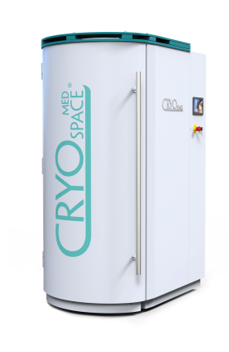
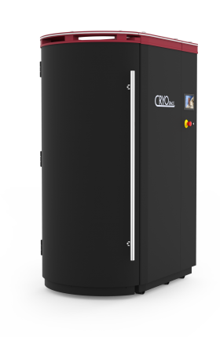
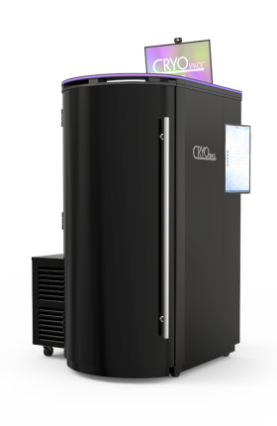
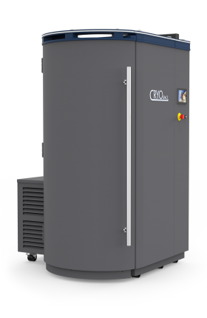
CRYOSPACE MED
CRYOSPACE ACTIVE
Certified for use in hospitals, clinics, doctor’s offices, physiotherapy practices, and more
CryoSpace® Med is medically certified by TÜV Rheinland
High-level entry model
Patented technology and durable materials
New dynamic liquid nitrogen distribution system for better performance and improved consumption
CRYOSPACE HYBRID
CRYOSPACE PRO
Most economical cryo cabine in the world
Unique hybrid system combining liquid nitrogen and electricity for optimal treatment temperatures while keeping consumption to a minimum
With ecological refrigerant R290
27” LCD curved screen with real-time heads-up display and built-in camera
23.8” touch screen panel for operator
Integrated Customer Management System via CryoSpace app.
Available for both Hybrid and Active model

Slide 37
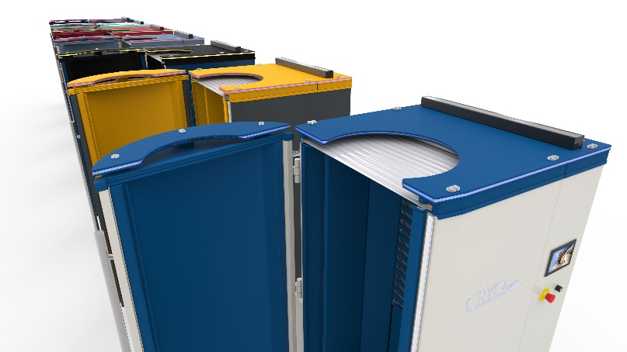
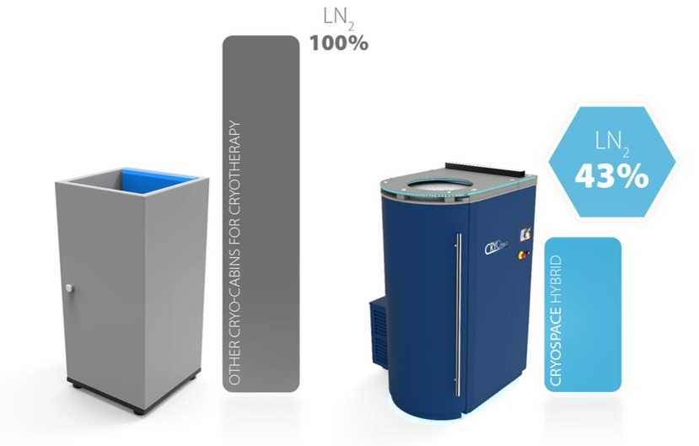
CRYOSPACE HYBRID HIGHLIGHTS
Most Economical Cryo System
Combining liquid nitrogen (for optimal treatment temperatures up to -194˚ Celsius) and an electric motor (saving up to 55% liquid nitrogen).
Designed To Keep It Cool
An automatic electric blind and certified cryogenic materials ensure minimal loss of cold escaping from inside the cabin.
Automate Your Precooling Schedule
Your CryoSpace will cool (and defrost) itself according to an automated schedule making it ready to use at your opening times.
Preprogrammed Treatments
Help and advise your clients with preprogrammed treatments based on scientific research.
Uses Electric Motor For Standby Mode
Minimize your cost when waiting for your next customer.

Slide 38
CRYOSPACE HYBRID FEATURES
Remote Maintenance And Diagnostics
Through WiFi connected system, including software updates
LED lighting
Colortherapy: where each color of the LED lights correspond with a specific treatment
Built-in Soundbar
Play your favourite music for in the cryo
Wide Standard Color Selection
8 standard inside and outside colors and optional custom color selection and logo
Ergonomics, Compact And Modular Design
CryoSpace will fit through any door (80cm) and is suitable for a wide range of users in terms of length (155-210 cm) and weight (max 150 kg)

Slide 39
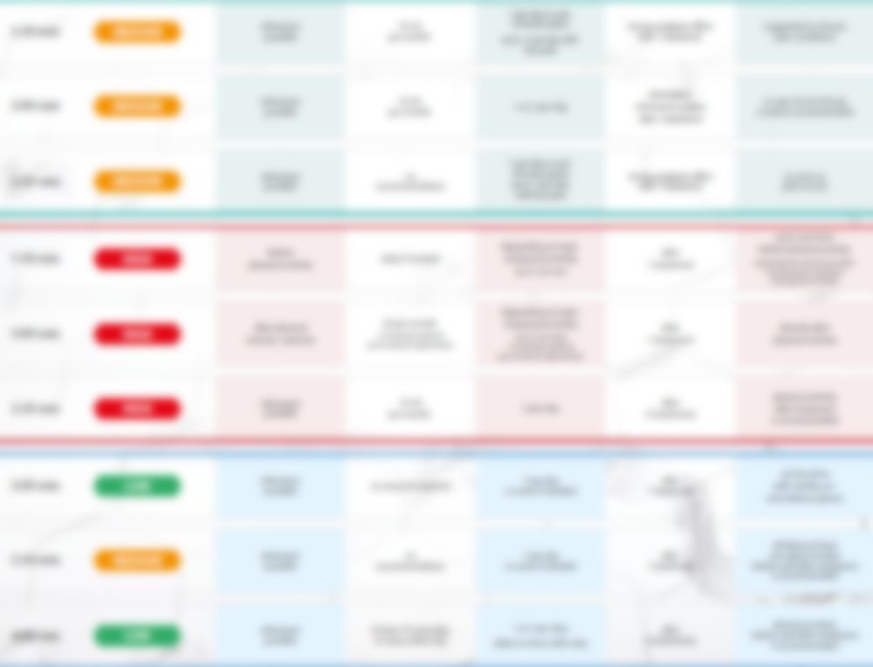
MENU
TREATMENTS BASED ON MEDICAL RESEARCH
Give your customers the best results with our unique system of preprogrammed treatments. Each treatment is based on years of know-how and medical research which determines the intensity, duration and frequency of the treatments based on the desired goal.

Slide 40
CRYOSPACE HYBRID PRO
The next generation of CryoSpace with additional focus towards User Experience.
FEATURES:
Heads-up display (27” LCD curved screen) with live session information for customer
Built-in camera to take photos during treatment and for customer monitoring
Integrated Customer Management System via CryoSpace Application
23.8” touch panel for operator
Presence sensor for additional safety
CUSTOMER MANAGEMENT SYSTEM:
Automation of post-treatment report sent to customer via email (including photo made during treatment)
Customer statistics and treatment history
QR code login for customers
Printer and tablet integration
Educational animations for users and operators
CRM and other software integration

Slide 41
THE COOLEST PLACE ON EARTH
„JBG-2” Sp. z o.o.
+48 32 720 41 08
cryospace@cryospace.eu
www.cryospace.eu
ul. Gajowa 5, 43-254 Warszowice
Poland

