Slide 1

TRAINING FOR OPERATORS AND USERS
CRYOSPACE HYBRID

Slide 2

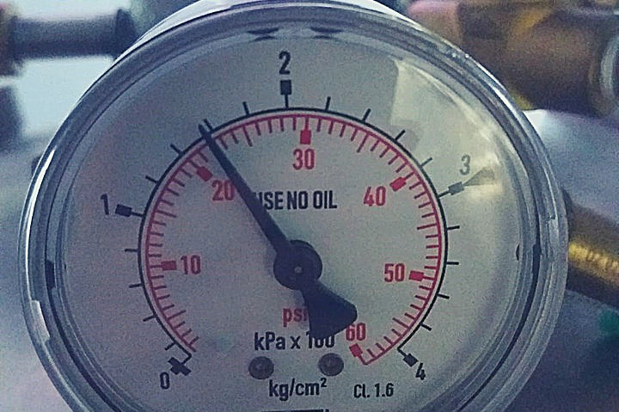
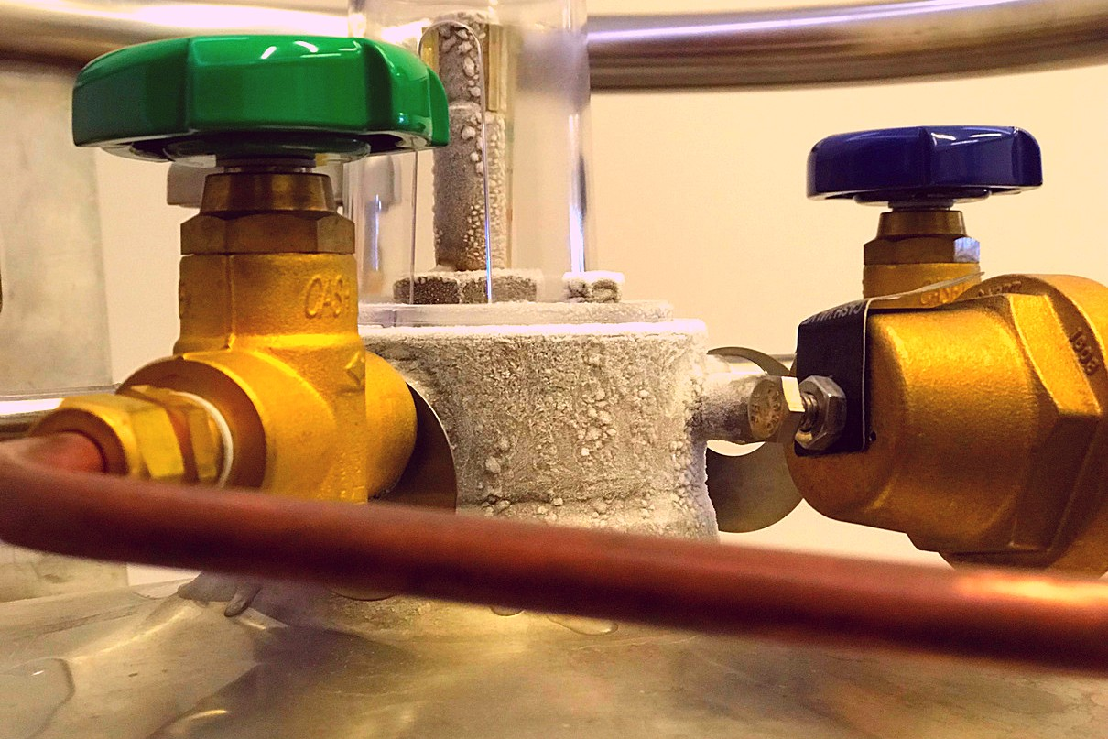
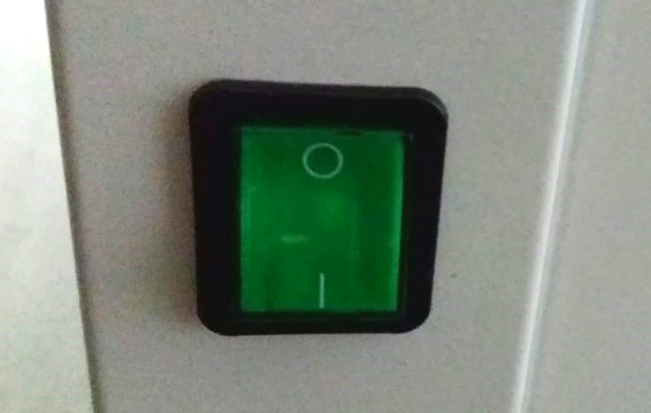
PART1 - TRAINING FOR OPERATORS
1.Check power
connection. Make sure the working pressure is 1,5bar and there is
enough nitrogen.
2. Open appropriate
valves as specified by nitrogen supplier.
3. Switch the cabin on
(green button at the back).

Slide 3
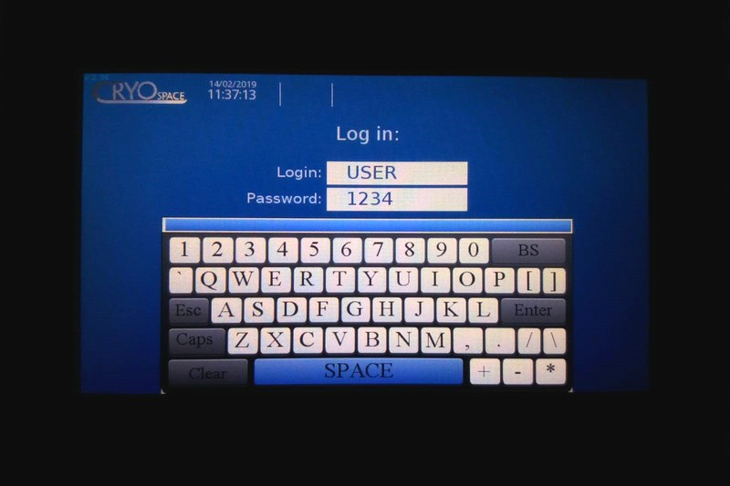
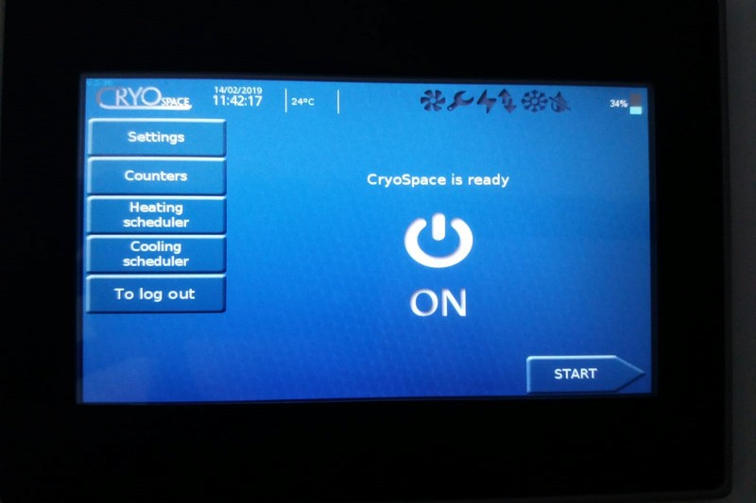
PART1 - TRAINING FOR OPERATORS
4. Login: USER Password: 1234
5. Touch the "ON" button to start
operation

Slide 4
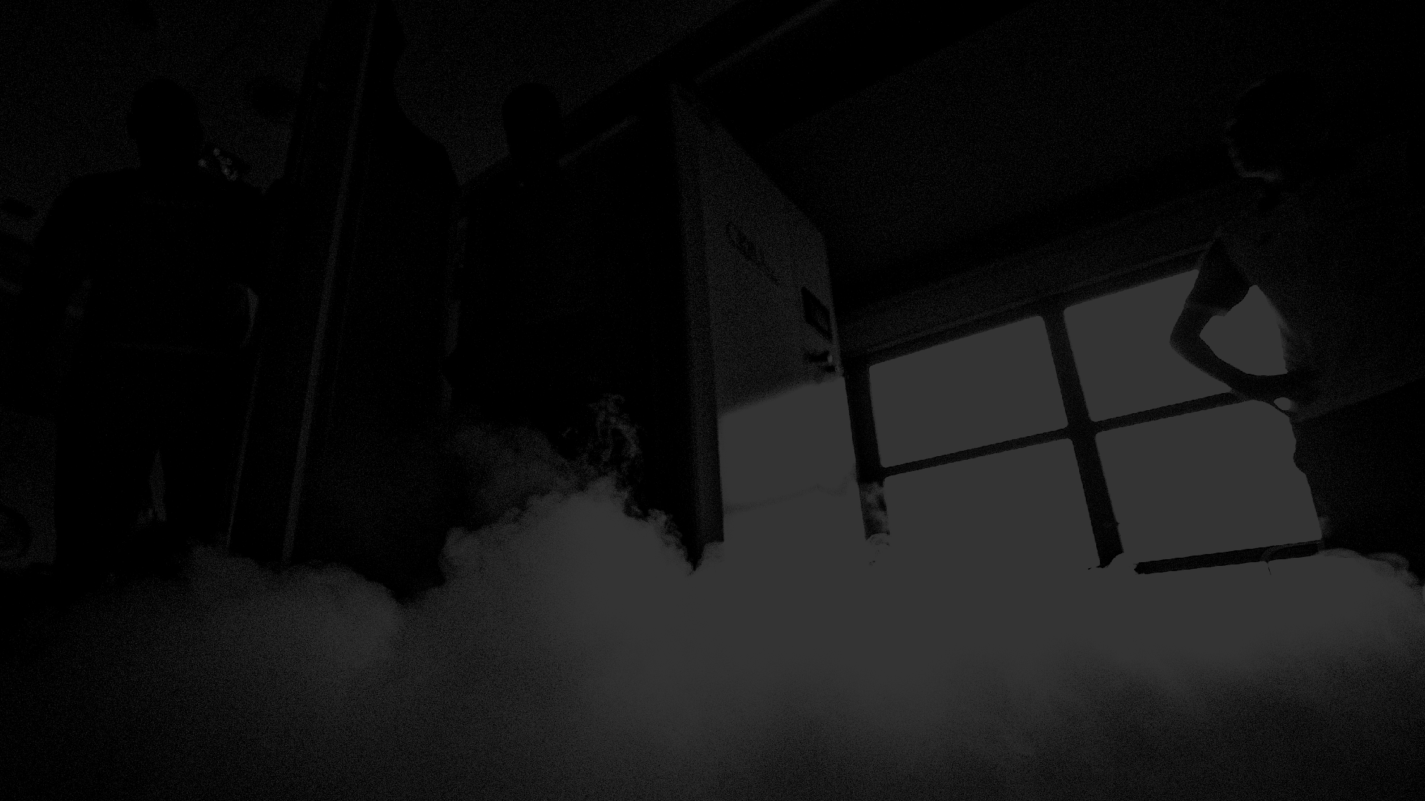
PART2 – TRAINING FOR USERS AND OPERATORS
Provide the user with a questionnaire for cryotherapy treatment –
this applies to those ‘very first time’ users (if there is a contraindication you should refer the user for a medical consultation).
After reading the form, there is a need to sign it by the user.
Provide a suitable cryotherapy outfit (depending on the facility). Standard cryotherapy clothing: long socks, slippers, cotton shorts, sports top (women), gloves.
Turn on the TURBO COOLING ("pre-cooling" process of the cabin) if the device has not been previously prepared with the ECO-COOLING
function.
Explain the color therapy functions – CRYOSPACE MENU
For 1st time users we recommend a treatment not longer than 2 minutes and in the LOW or MEDIUM intensity option.

Slide 5
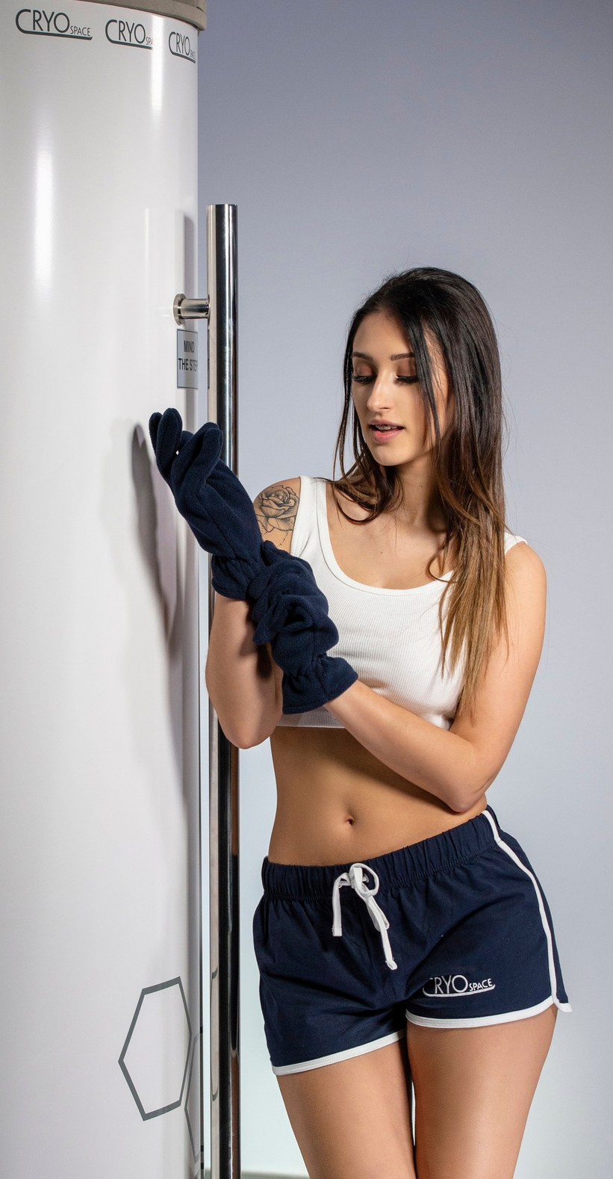
The operator explains to the user BEFORE TREATMENT what awaits him during the procedure:
After setting the treatment parameters, you will be invited to go into the cabin.
After entering and closing the door, the elevator will raise to the appropriate height, so that the head is outside the cabin, and the arms are level with the cabin's collar; after the elevator stopps and the operator checks the height of the user, the operator will be able to start the cryotherapy session. There is still possibility to change user's height.
The operator is in direct contact with the user at all times; talks,
makes sure the user feels comfortable, informs about the remaining time until the end of the procedure.
Inhalation of nitrogen vapors from inside the cabin is prohibited.
The head must be above the device flange and should point slightly upwards.

Slide 6
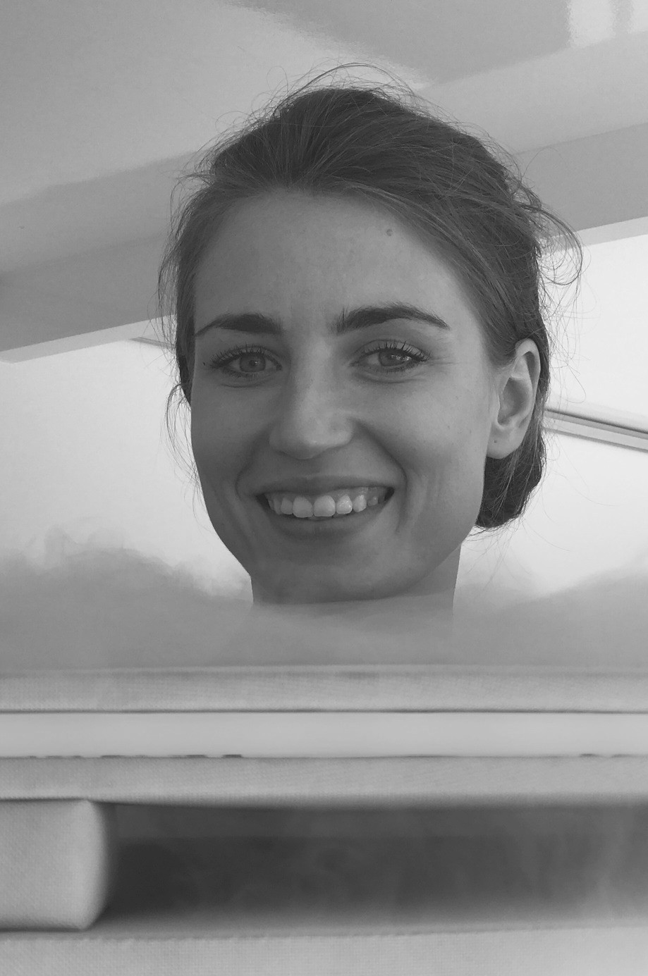
We suggest to move around in a moderate pace without rubbing against the unit's interior.
It is not recommended to open the door during the treatment. Explain that it is possible to open the door at any time, however warn the user that when opening the door during the procedure there is a risk of falling out of the cabin.
At the end of the treatment the cold mist will be extracted from the cabin and simultaneously the lift will go down. The user waits inside for operator to open the door after the sound signal.

Slide 7
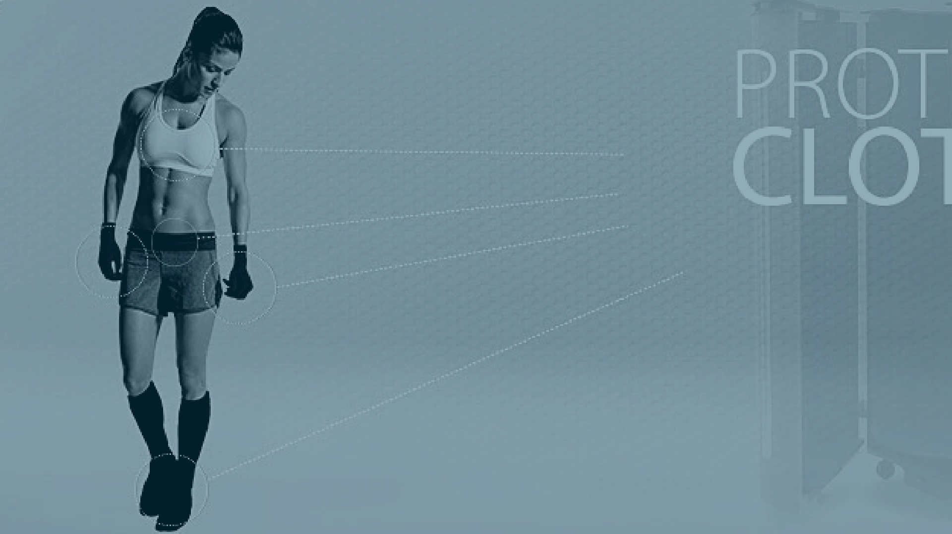
7. After explanations of the whole procedure the operator checks the outfit and asks about skin condition (dry/without
jewelerry/ without open wounds).

Slide 8
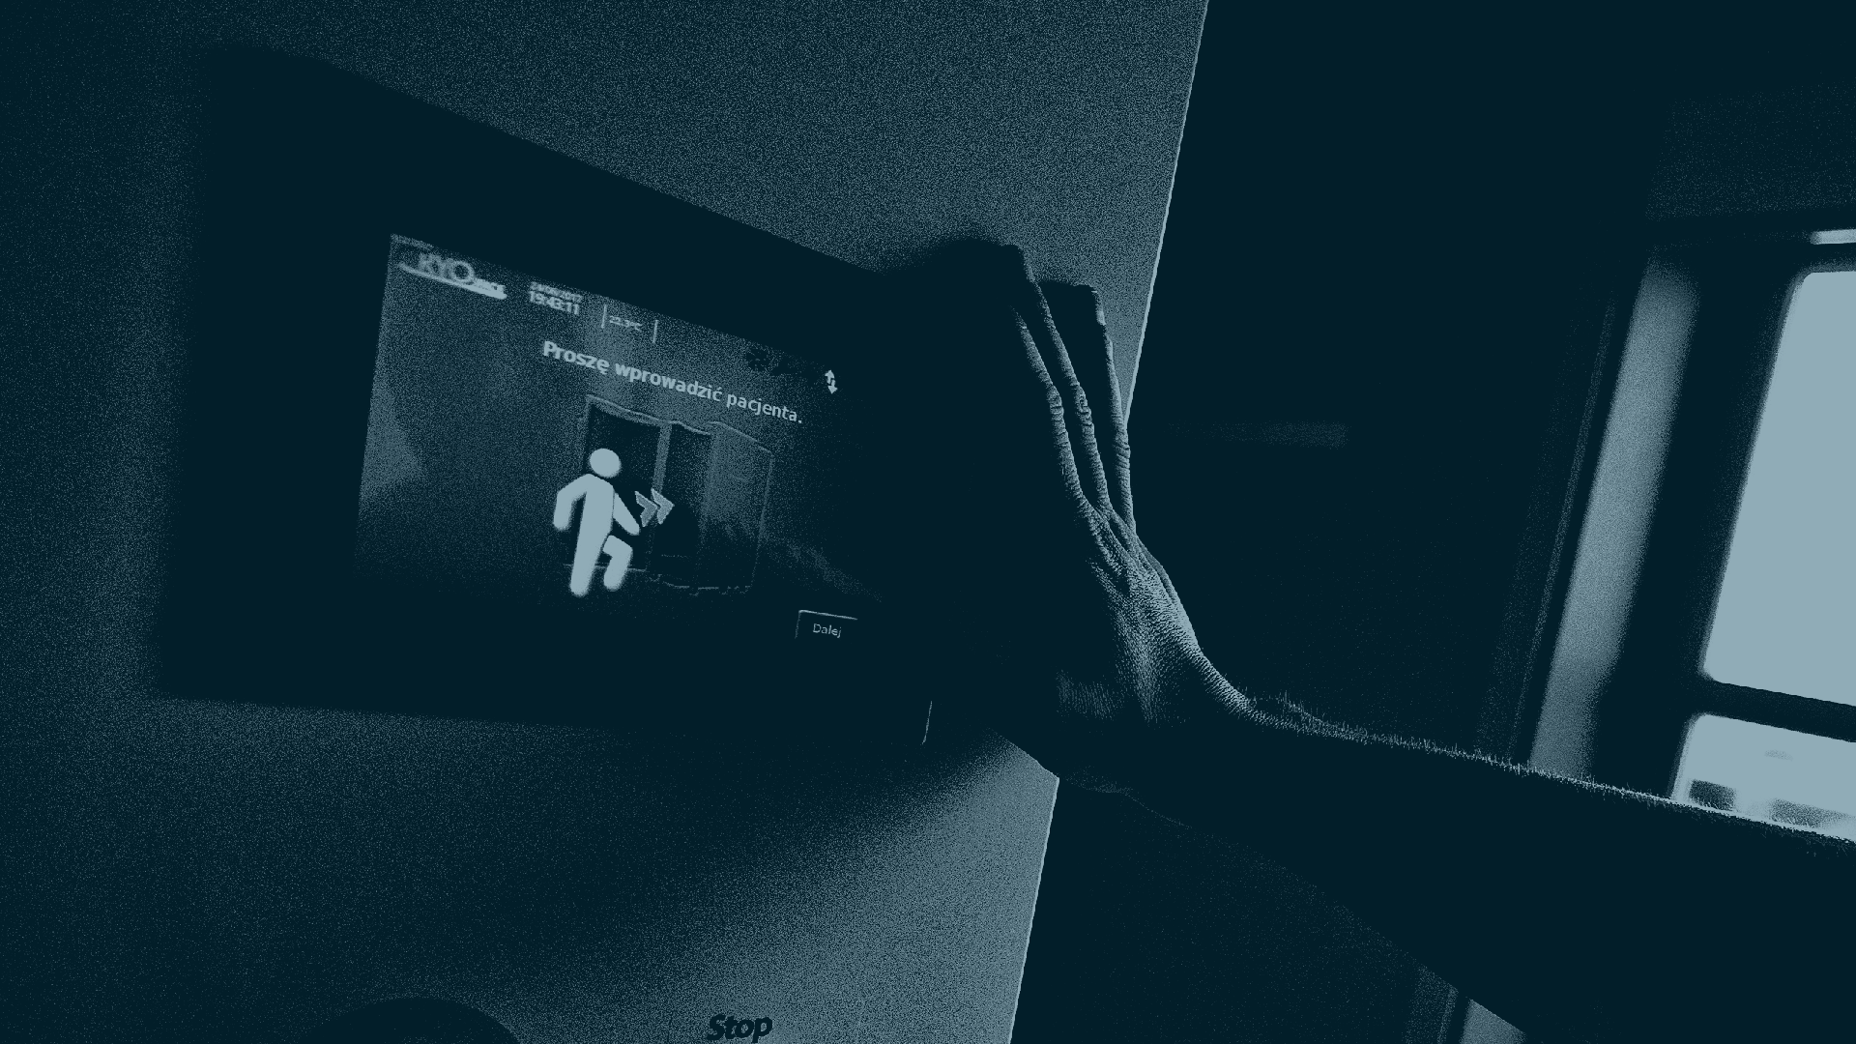
8. Set the treatment parameters: intensity, colour, time and user's
height.

Slide 9
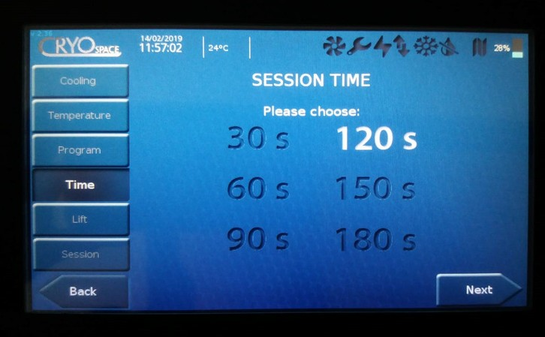
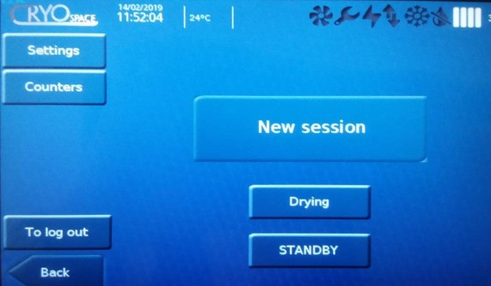
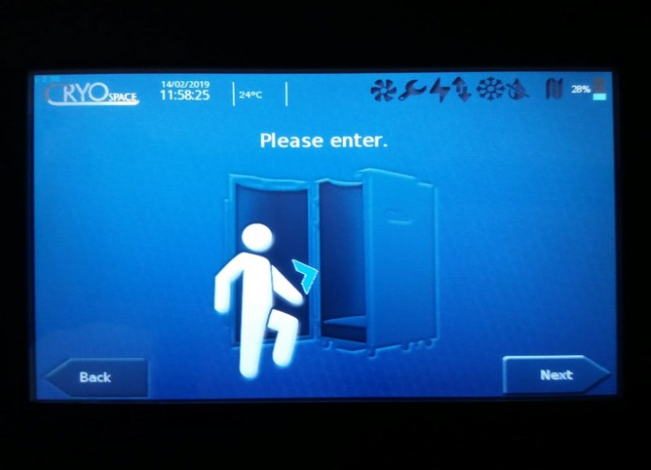
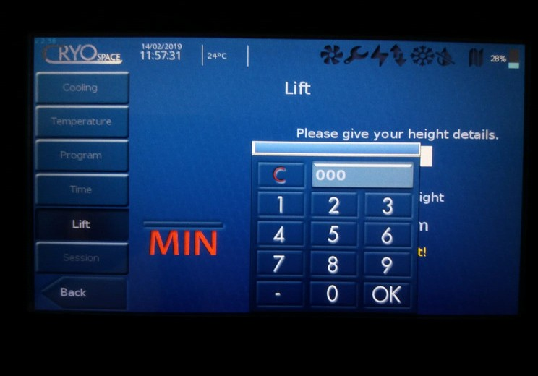
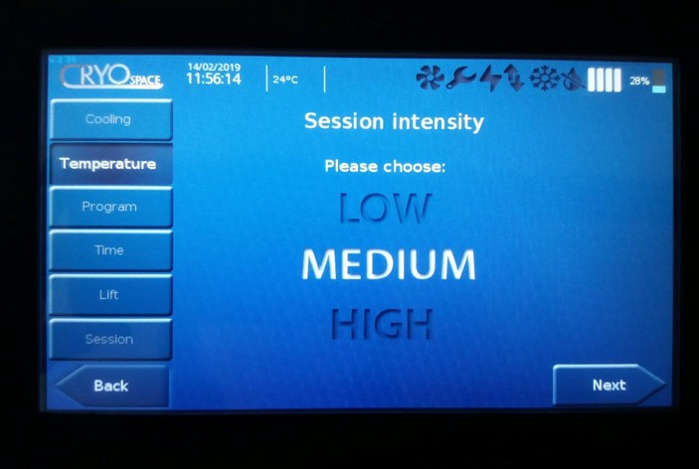
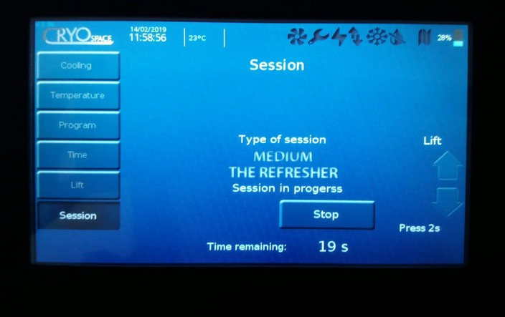
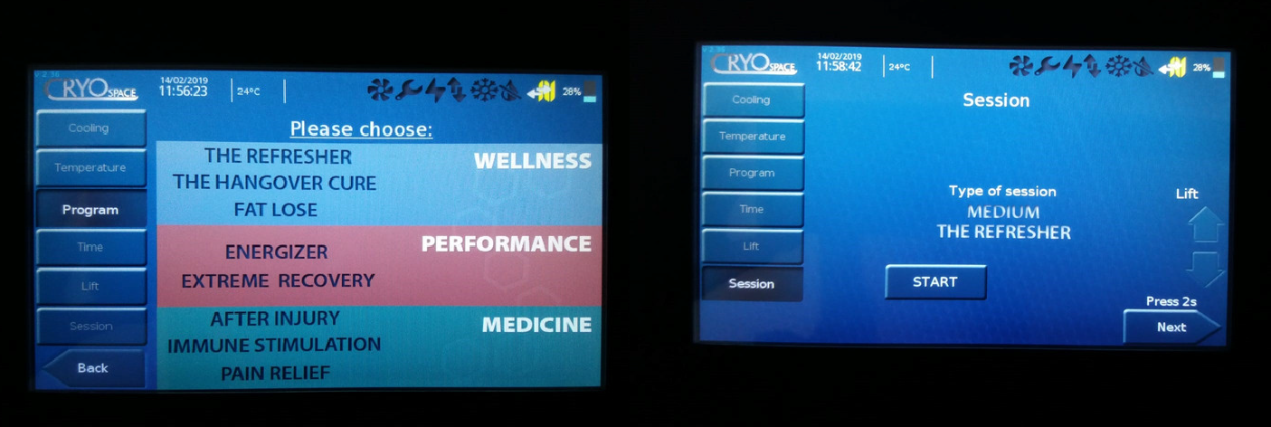
1.
4.
7.
2.
5.
8. Set the treatment parameters:
intensity, colour, time and user's height.
8.
3.
6.

Slide 10
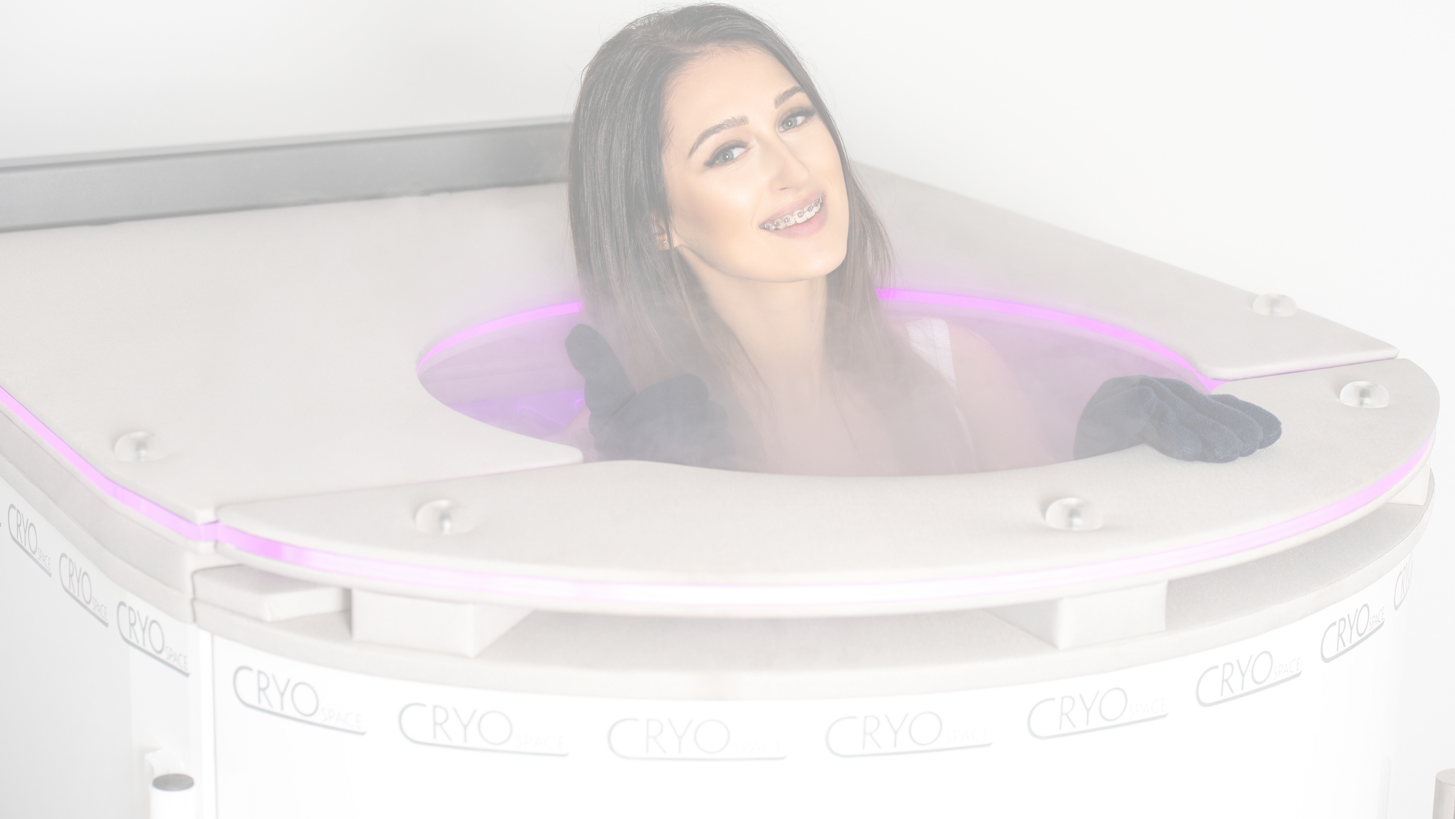
9. The user enters the cabin, the lift
reaches appropriate level. The operator checks if the height is adequate and only then the treatment can be started. The right height is the one in which the user, standing freely, has the arms at the height of the upper flange of the cabin.

Slide 11
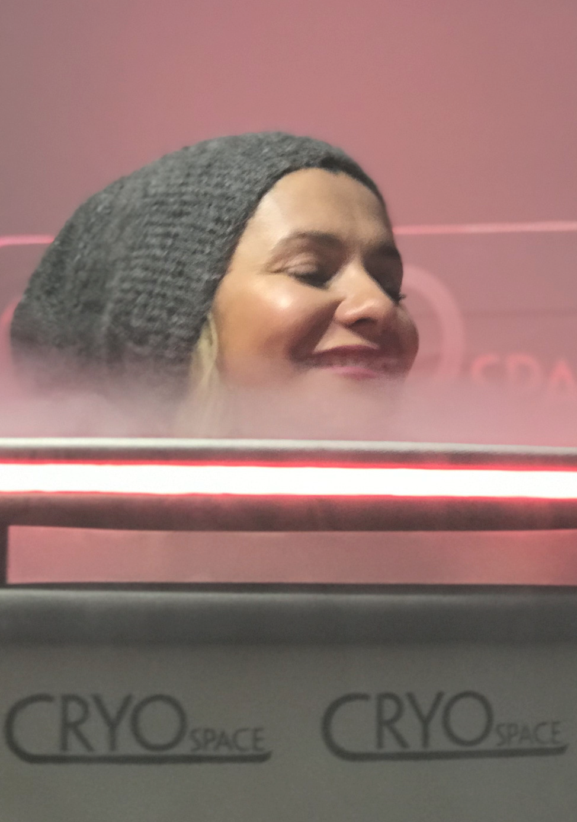
DURING THE SESSION. The operator talks with the user all the time and draws attention to:
Head pointing up - do not inhale the nitrogen vapour. The user has to move around without touching the cabin's interior.
Time left till the end of treatment has to be communicated from time to time.
If the user stops talking / answering questions, operator immediately stops the treatment.
When the lift goes down the user is still inside the cabin.
The operator opens the door only after the sound signal.

Slide 12
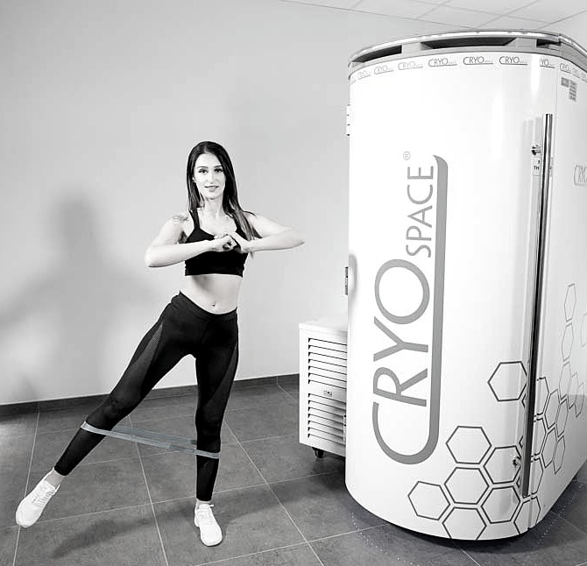
AFTER TREATMENT
After the session, the user can stay in cryotherapy outfit or changes into sports clothing.
A moderate physical activity is recommended for ca. 20 minutes.
Operator closes the valves on
the container after all treatments are finished.

Slide 13
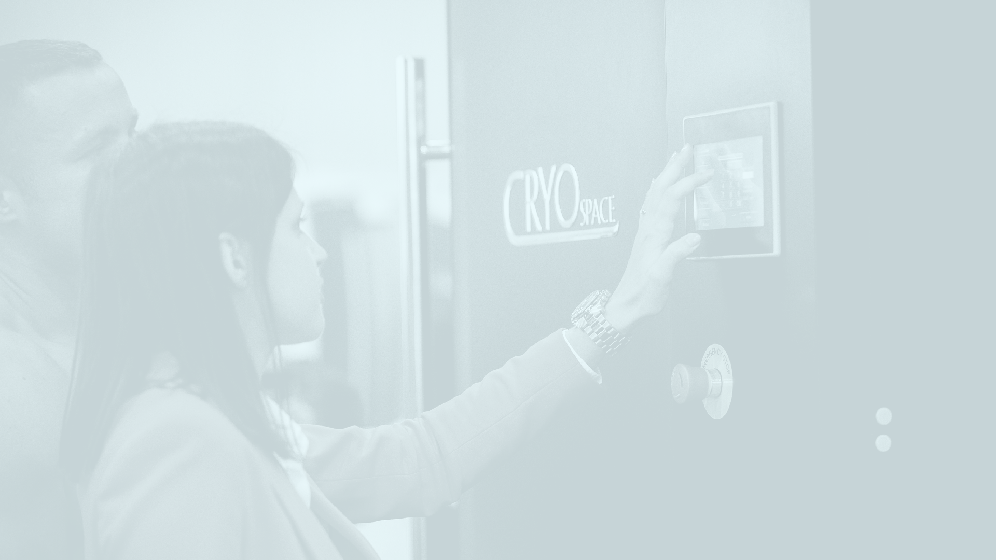
PART3 - TRAINING FOR OPERATORS

Slide 14
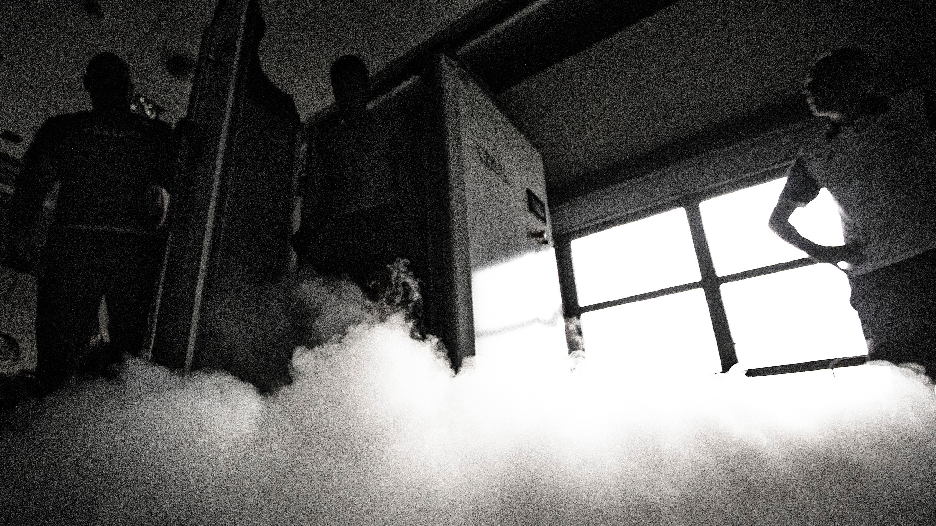
STAND-BY function
In the cases of booking clients with a few-minute interval between treatments or when a given client is late, it is recommended to activate the ECO STAND-BY function in order to maintain low temperatures inside the cabin. After activating this function, the automatic blind closes and the electric cooling process begins.
ECONOMIC VERSION - RECOMMENDED.
The operator can also choose the STANDARD STAND-BY function that maintains low temperatures inside the cabin with liquid nitrogen.

Slide 15
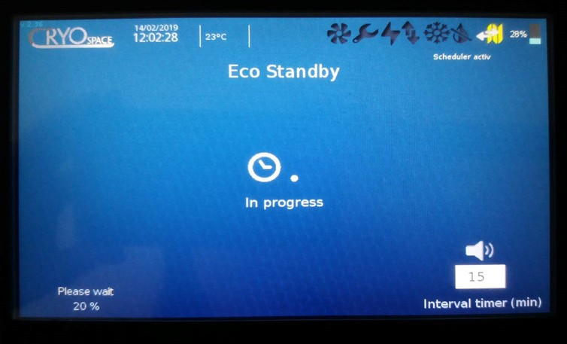
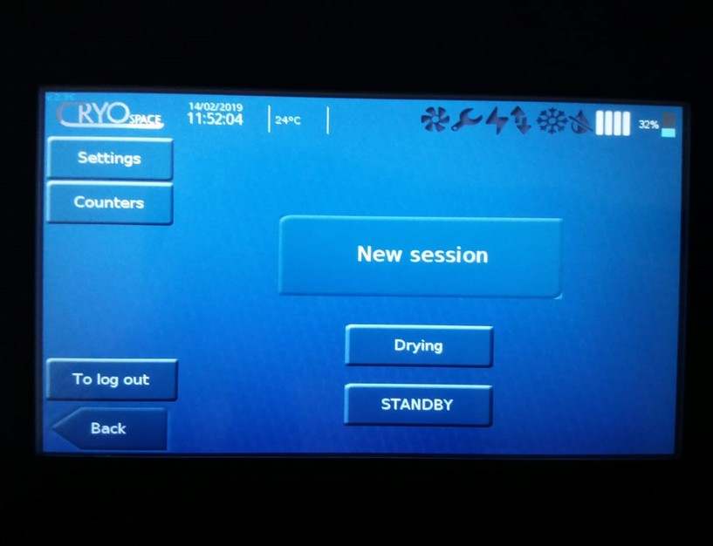
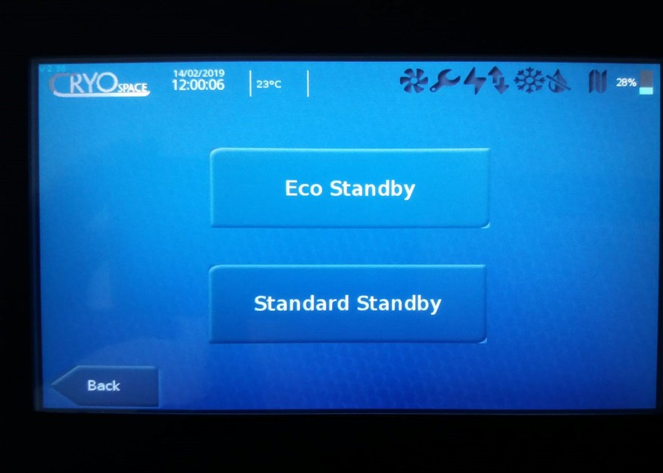
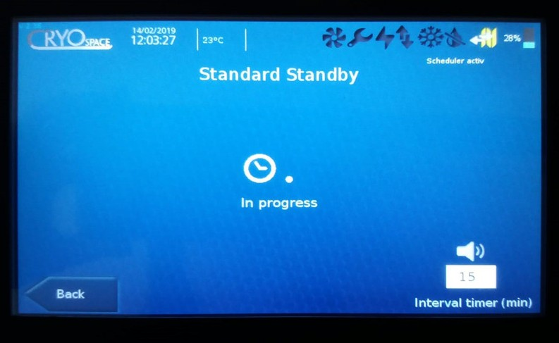
STAND-BY function

Slide 16
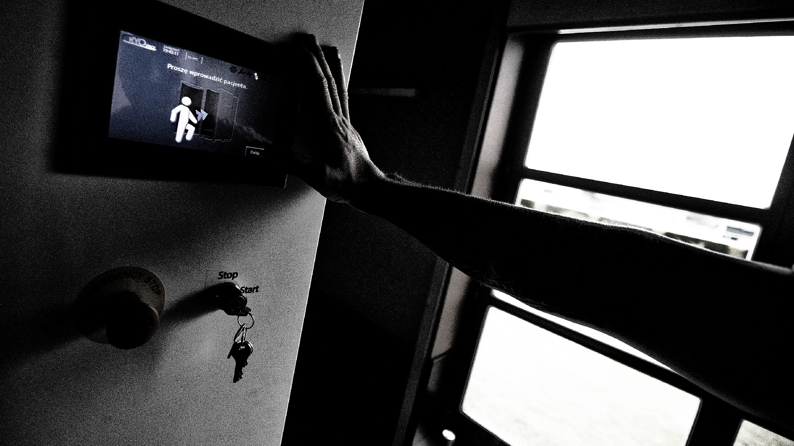
COOLING SCHEDULE
To start the ECO COOLING schedule for the next days, enter the cooling schedule tab. Choose the days and time for each cooling start-up, and then press 'Save changes' button.
The schedule for ECO-COOLING is the priority schedule. It stops drying if it is activated. Remember not to switch off the device when you plan to activate the cooling schedule for the next day.
In case the device reaches the maximum cooling temperature, the automatic
change from the COOLING function to the ECO STAND-BY function takes place.
We leave the door closed.
We close the nitrogen inlet valve and the pressure relief valve on the tank.

Slide 17
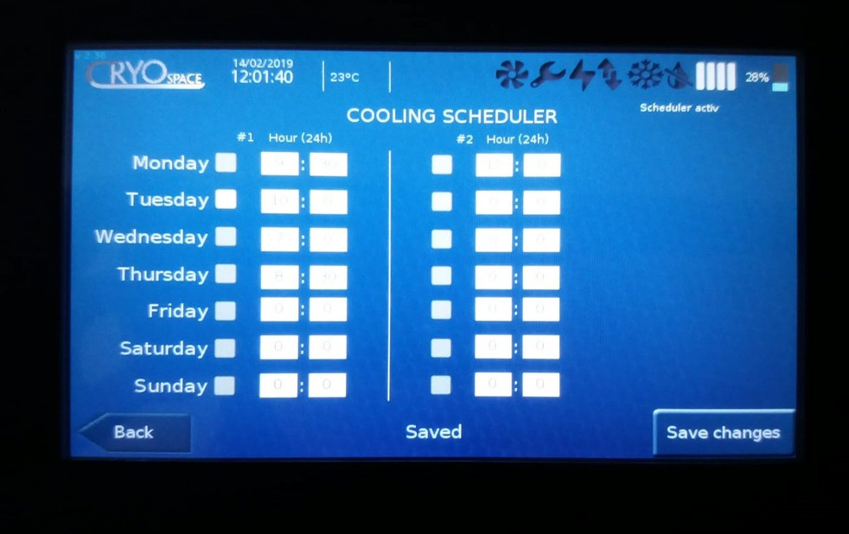
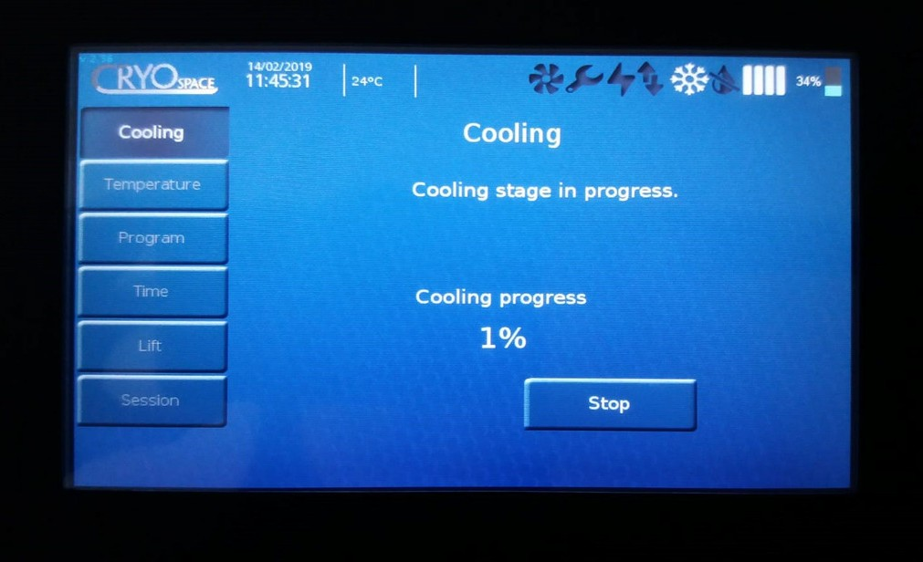
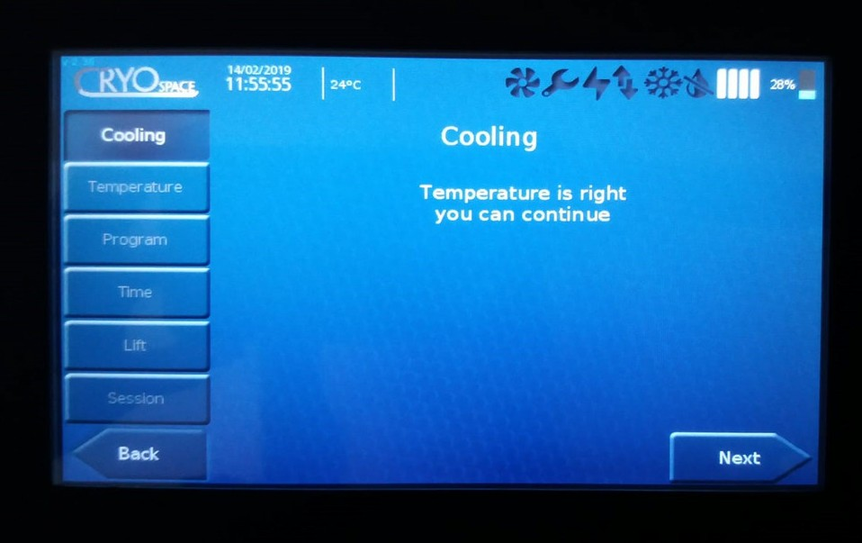
COOLING

Slide 18
DRYING
Select the drying function on touch panel, if the device requires it (required after 3 hours of continuous operation).
You can also use the DRYING schedule for this function. The DRYING schedule works analogously to the COOLING schedule, except that it does not interrupt the operation of the cabin if it is activated.
In case of cooling the cabin during the day using the ECO-COOLING method, drying is recommended at the end of the day.
Both cooling and drying schedule can be set in advance at two times a day.

Slide 19
Thank you!

