Slide 1
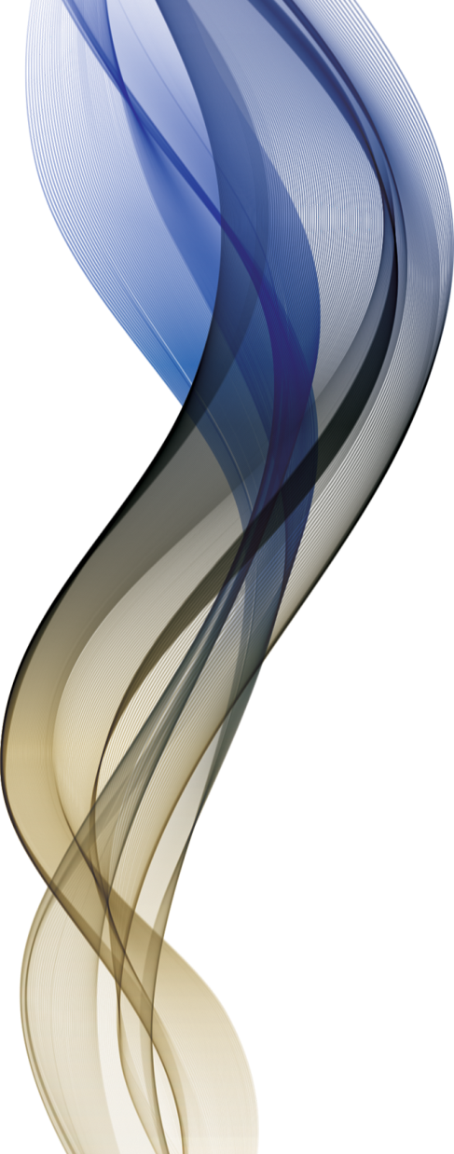
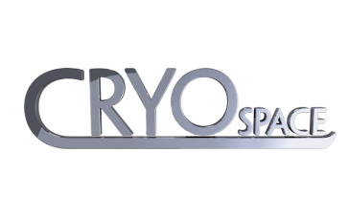
WHOLE-BODY CRYOTHERAPY
and its medical applications

Slide 2

Cryotherapy [gr. krýos „ice”, „cold”+ gr. therapeía „ therapy”]:
cold therapy
Whole-body cryotherapy
„stimulative, short-term use of cryogenic temperatures (below -100°C) applied superficially (2-3 minutes) in order to elicit and make use of physiological, biochemical body reactions to cold, support the medical basic therapy and ease the treatment by movement”.
Skrzek A., Podbielska H. Wykorzystanie niskich temperatur w biomedycynie
– podstawowe definicje. 2012, 34

Slide 3
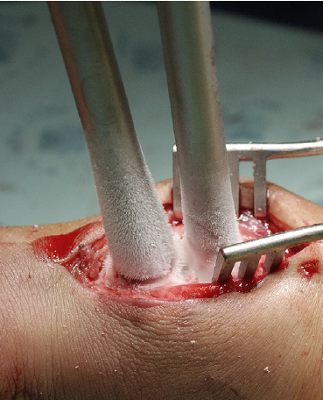
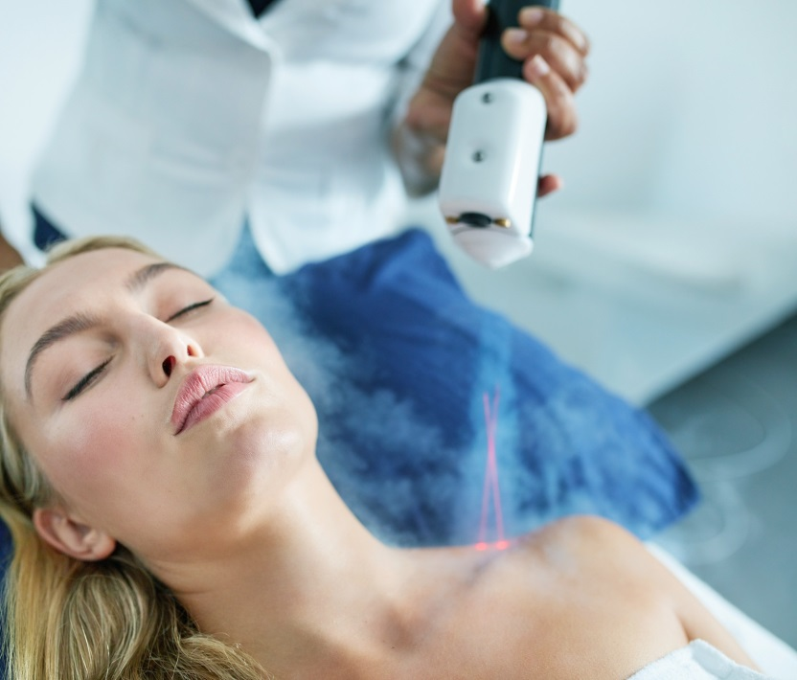
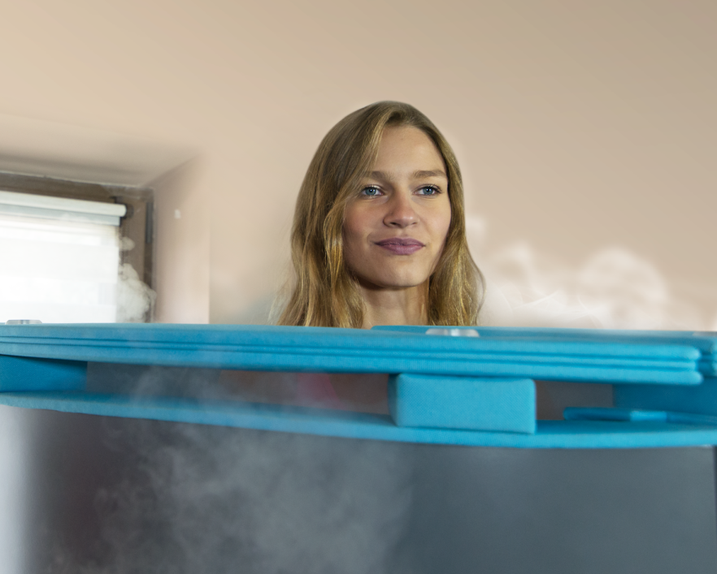
CRYOTHERAPY - CLASSIFICATION
Cryosurgery
Cryostimulation
damaging effect
non damaging effect
local
whole body

Slide 4
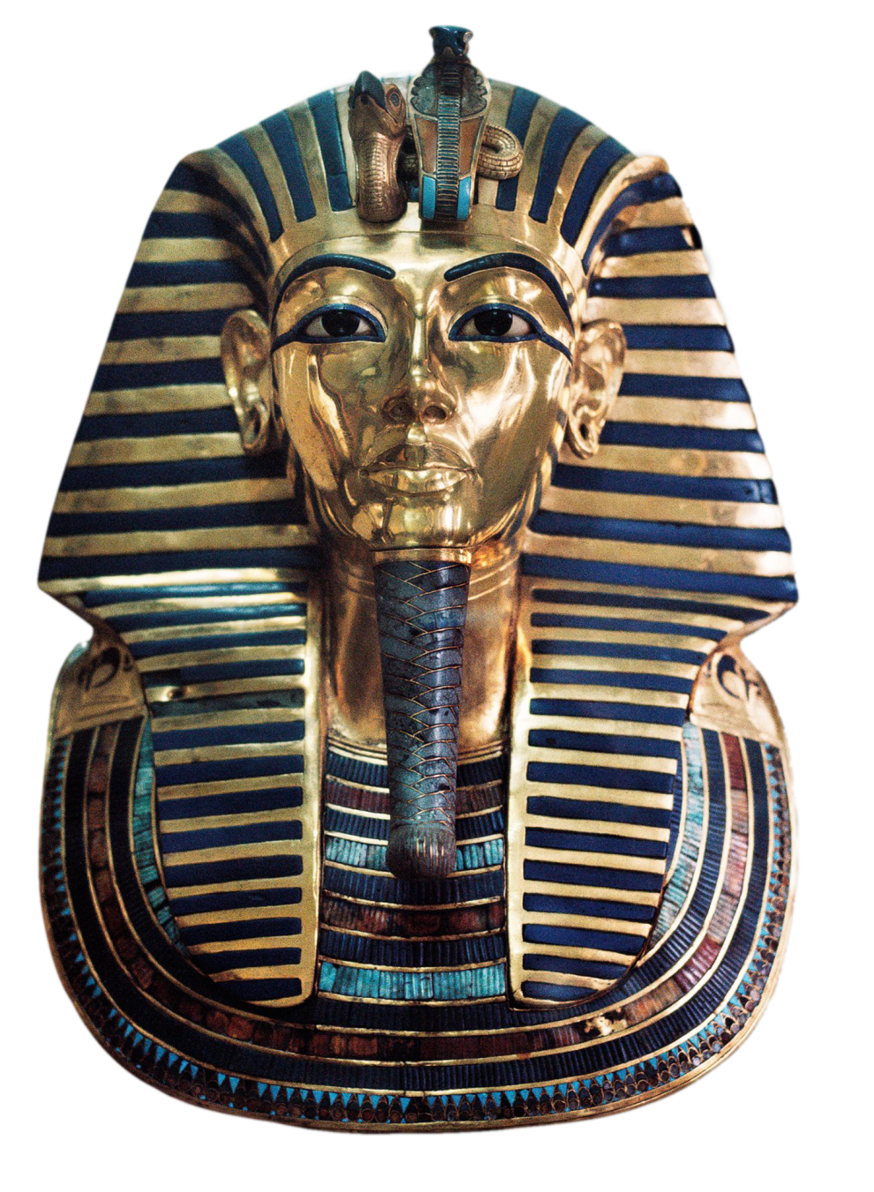
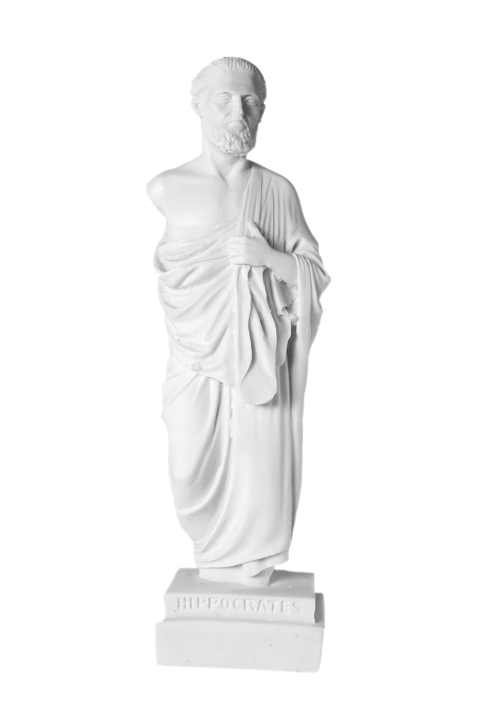
History of cold usage
The Egyptians used cold to treat injuries and inflammation as early as 2500 BCE.
Hippocrates used cold to reduce pain, swelling and bleeding
Dominique-Jean Larrey, Napoleon's legendary surgeon, used it to facilitate amputations during historic retreat from Moscow
Between 1845 and 1851, Dr. James Arnott of Brighton, England, described the benefits of local cold application in the treatment of numerous conditions, including headaches and neuralgia.

Slide 5
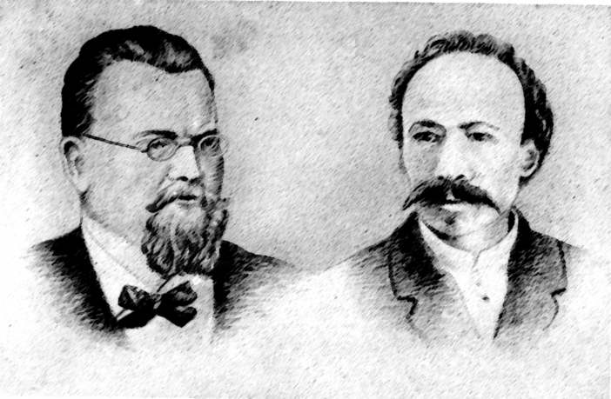

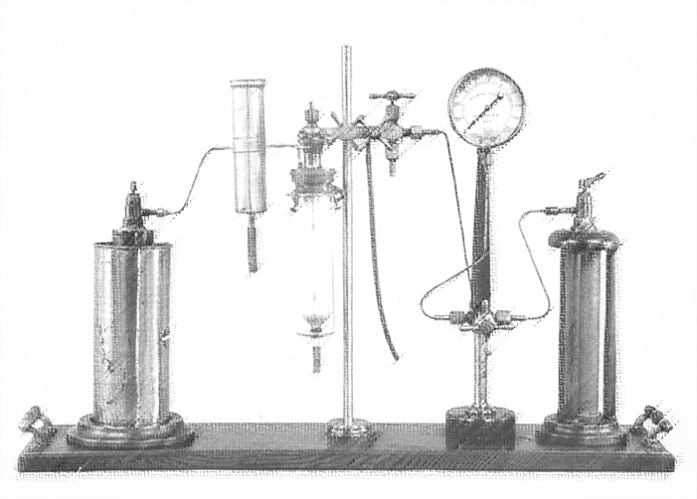
History of cold usage
In 1883 Karol Olszewski and Zygmunt Wróblewski succeeded in condensation of oxygen -183°C , nitrogen -196°C and hydrogen -253°C
In 1907, Whitehouse reported a series of fifteen skin cancers treated with cryotherapy with good results. He described the use of a spray bottle, although he found this technique difficult and stopped using it in favor of a cotton swab: first device with vapour of liquid nitrogen
Following World War II, liquid nitrogen (-196°C) became commercially available.

Slide 6
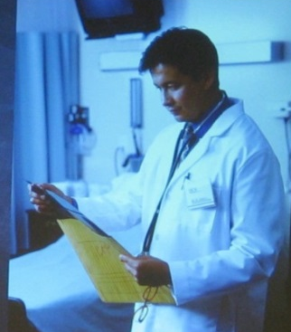
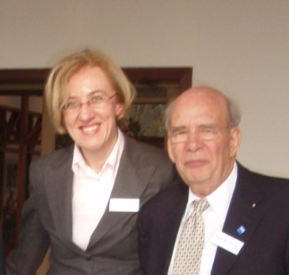
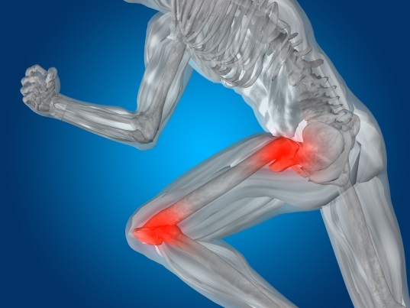
History of cryotherapy
First whole body cryochambers
1978: T. Yamauchi (Japan) – first application of WBC in cryochamber (whole body cryotherapy) for the patients ill with rheumatoid arthritis
1982: R. Fricke (Germany) – first application of WBC in Europe

Slide 7
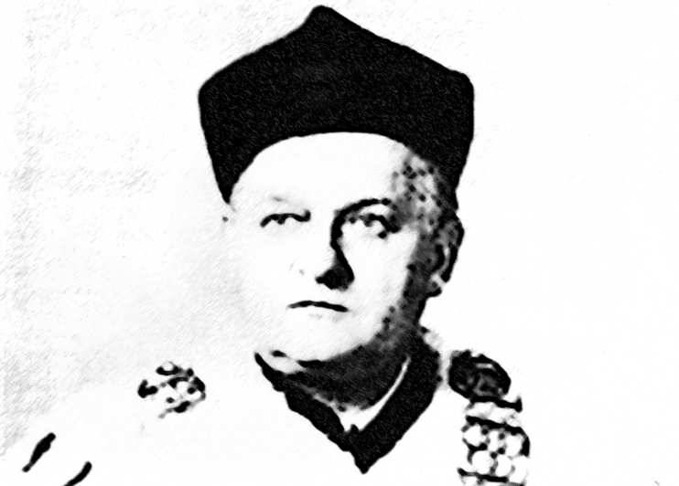
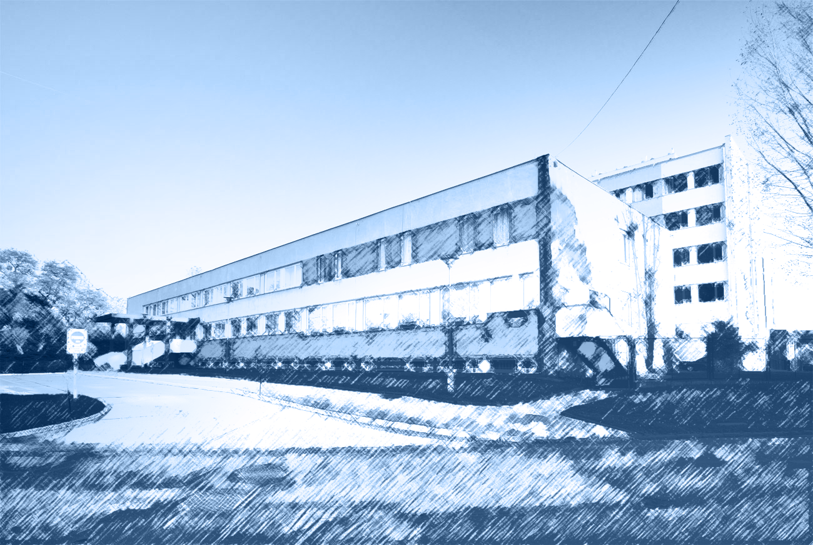
History of cryotherapy
1983: prof. Z. Zagrobelny (School of Physical Education Wroclaw): first treatments using the local cryotherapy method; initiatior of the application of cryogenic temperatures in physiotherapy
1989: first cryochamber in Poland and third in the world (designed by Zbigniew Raczkowski from the Institute of Low Temperatures and Structural Studies of Polish Academy of Sciences in Wrocław)

Slide 8
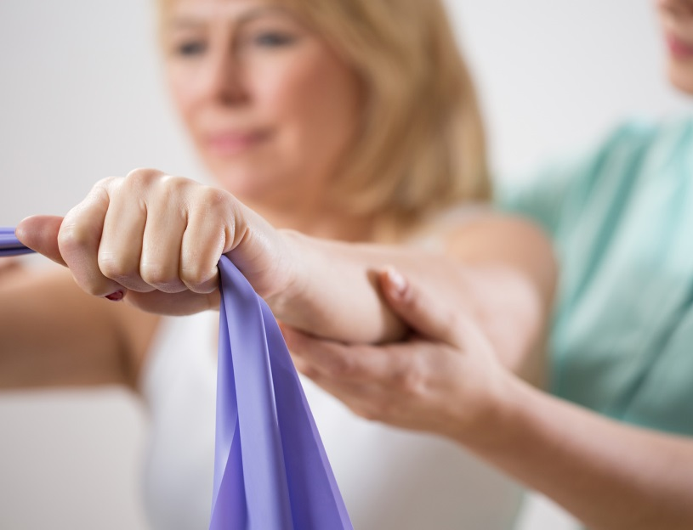

Cryotherapy: main indications
3. Application of WBC in sports:
Posttraumatic
Regenerative in order to enhance physical performance
Relaxing/ soothing for muscles
Mood improvement
Reduction of overtraining effects
Anti-inflammatory and anti-swelling application
1. Clinical indications:
Depression, anxiety, insomnia
Neurological disorders (Alzheimer, MS, fibromyalgia)
Disorders of locomotor system
Disorders of circulatory system
Condition (skin, mental, immunological resistance)
2. Indications for physical rejuvenation:
Perception of reality/mood
Skin quality, regeneration of cells, collagen production
metabolism
Inflammatory/after medical treatments

Slide 9
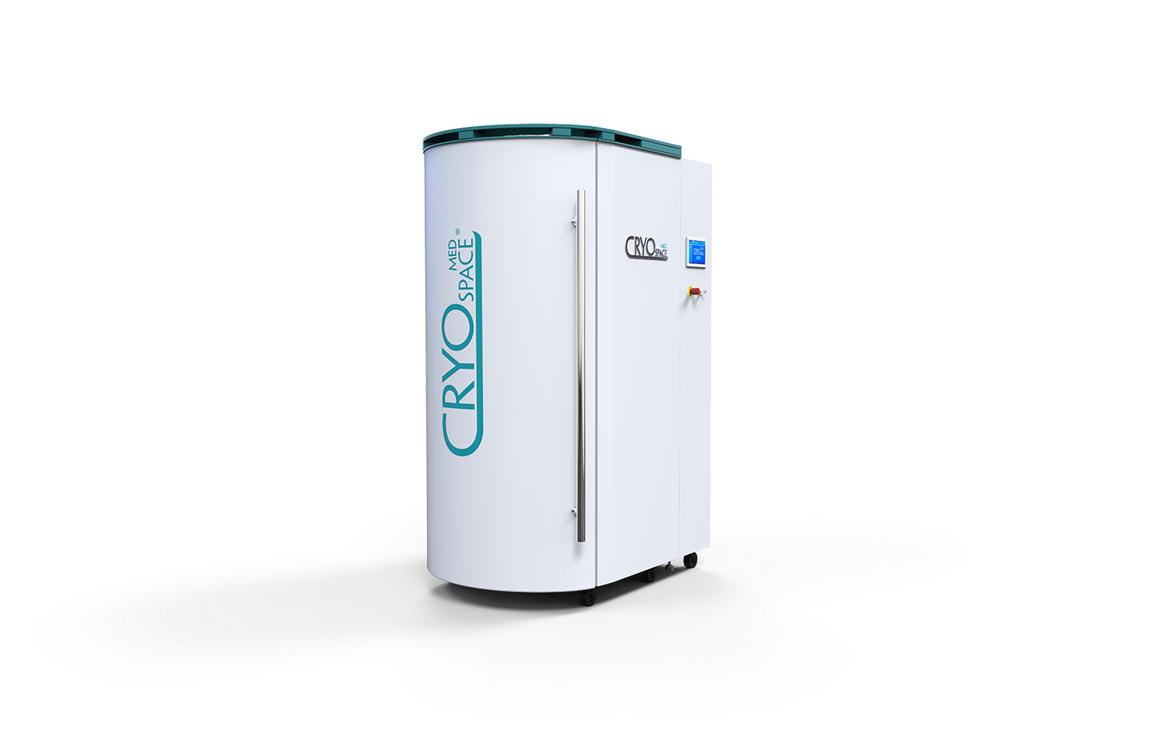
CryoSpace® Med – a medical device for whole-body cryotherapy
Average temperature options from -100 °C to -140 °C
Duration of treatment between 30 and 180 seconds
Operation via touchscreen
Ready for operation in max. 8 minutes
Plug and Play (required power supply: 220–240 V)
Patent-pending air circulation system for even distribution of the low temperatures within the cabin
Automatic extraction of nitrogen vapours from the cabin
Free movement with spacious interior
Mobility of the equipment thanks to built-in wheels
Optional exterior colour selection (customized powder coating available on request)

Slide 10
CryoSpace Med – Technical Data
Dimensions (fig. 1) | 2120 (height) x 1400 (width) x 1050 (depth) [mm]
Weight of the cabin without nitrogen tank | 480 kg
Power supply | 230 V AC 50/60 Hz
Maximum power consumption for the device | 2500VA
Class of protection against electric shock | I
Type of application parts | B
Display | touch-7 "
Degree of protection against the influence of the environment | IP 20
Average temperature in the cabin | -100°c to -140°c
Pre-cooling time | ca. 8 min
Pre-cooling nitrogen consumption | averagely 11 kg
Duration of 1 session | 30 to 180 s
Max. recommended time to carry out a series of sessions | 3 h
Drying time | 1 h
Maximum working load of the lift | 150 kg
Nitrogen consumption | averagely 1 kg/min
Minimum nitrogen consumption | ca. 0.5 kg/min
Period of use | 10 years

Slide 11
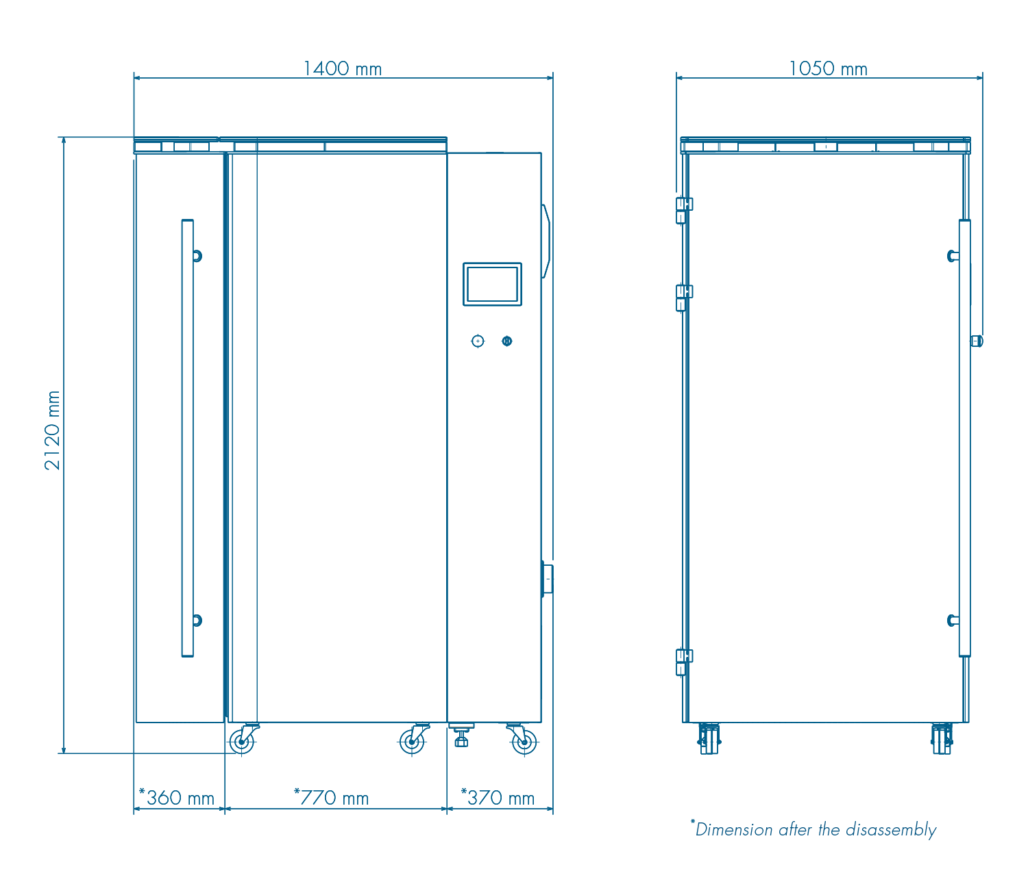
CryoSpace Med – Cross section
Fig. 1

Slide 12
Treatment facilitates the following physiological and psychological healing processes in the body:
Pain relief, anti-inflammatory and anti-swelling effect
Activation of hormone production (mood elevation, enhanced sleeping quality and energy budget, activation of libido, reduction of anxiety disorders and motoric hyperactivity)
Positive impact on mental disorders (e.g. depression)
Improvement of the immune system
Reduction of cholesterol level (significant reduction of LDL/increase of HDL)

Slide 13
Treatment facilitates the following physiological and psychological healing processes in the body:
Accelerates recovery and regeneration processes after overloads and/or injuries
Facilitates the rejuvenation process and tissue recovery (increased collagen production)
Enhances the effect of many orthopedic therapies (e.g. for rheumatism, back pain)
Increases testosterone level in men (with concurrent positive reduction of estrogens)

Slide 14
Cryotherapy and Fibromyalgia
52% PAIN RELIEF AFTER 20 TREATMENTS
52% REDUCED NUMBER OF PAINFUL POINTS OF THE BODY
2-3 min in temperature -150°C to -110°C
1 treatment per day
Source: Zastosowanie niskich temperatur w biomedycynie, red. Halina Podbielska, Anna Skrzek, Oficyna Wydawnicza Politechniki Wrocławskiej, Wrocław 2012, s. 222.

Slide 15
Pain relieving effects after Cryotherapy
Significant decrease in pain perception!
1 treatment per day for the first 7 days, then 2 treatments per day for the remaining 18 treatments
3 minutes per treatment in temperature -160°C
1 treatment per day
3 min in temperature -156°C to -130°C
1 treatment per day
3 min in temperature -120°C to -110°C
Source: Clinical assessment of whole body cryotherapy treatment outcomes in fibromyalgia, Kuehne, J G&G Healthcare, Los Angeles, CA, USA; Preliminary Overview: Clinical Relevance of Whole Body Cryotherapy, Alan G. Christianson, NMD, p.4; Wpływ krioterapii ogólnoustrojowej na dolegliwości bólowe chorych na reumatoidalne zapalenie stawów, Katarzyna Krekora, Aleksandra Sawicka, Jan Czernicki, Uniwersytecki Szpital Kliniczny nr 5 w Łodzi, p. 3.

Slide 16
Cryotherapy in depressive and anxiety disorders
WBC reduces the severity of depressive and anxiety symptoms
1 treatment per day
2-3 min in temperature -160°C to -110°C
1 treatment per day
2-3 min in temperature -170°C to -120°C
1 treatment per day
2-3 min, in temperature -160°C to -110°C
Source: Whole-body cryotherapy as adjunct treatment of depressive and anxiety disorders, Joanna Rymaszewska, David Ramsey, Sylwia Chładzińska-Kiejna, Archivum immunologiae et therapiae experimentalis. 56(1):63-8; Zastosowanie niskich temperatur w biomedycynie, red. Halina Podbielska, Anna Skrzek, Oficyna Wydawnicza Politechniki Wrocławskiej, Wrocław 2012, s. 261.

Slide 17
Cryotherapy and Rheumatoid Arthritis
1 treatment per day
3 min in temperature -156°C to -130°C
Treatment twice a day
Source: Preliminary Overview: Clinical Relevance of Whole Body Cryotherapy, Alan G. Christianson, NMD, p. 4, 8; WORLD-WIDE STUDIES Of WHOLE BODY CRYOTHERAPY, Whole-body cryotherapy in patients with inflammatory rheumatic disease. A prospective study, p. 2.

Slide 18
Improved performance in sport
Increased power by 13%, 2 treatments per day
Improved suppleness by 23%
2 treatments per day
3 min in average temperature -150°C
1 treatment per day
2 min in temperature -130°C to -160°C
Source: Wpływ kriostymulacji ogólnoustrojowej na niektóre reakcje wysiłkowe u sportowców (doniesienia wstępne), Sport wyczynowy nr 5-6, 2003, J. Chwalbińska-Moneta, p. 51-54.; „http://www.balneologia.lo.pl/bp/bp3_08.htm ZMIENNOŚĆ WYBRANYCH CECH MOTORYCZNYCH CZŁOWIEKA W ZALEŻNOŚCI OD TEMPERATUR KRIOGENICZNYCH (-130°C I -160°C) Joanna Łuczak, Joanna Michalik"

Slide 19
Recommended usage
Once or twice a day, according to the generally accepted protocol for these treatments in a cryogenic chamber
In case of more treatments in one day, a 3-4 hour break should be kept between them
Frequency of treatments should be adjusted to individual needs
Source: THE INFLUENCE OF SINGLE WHOLE BODY CRYOSTIMULATION TREATMENT ON THE DYNAMICS AND THE LEVEL OF MAXIMAL ANAEROBIC POWER, A.T. KLIMEK, A. LUBKOWSKA, Z. SZYGUŁA, B. FRĄCZEK, M. CHUDECKA, International Journal of Occupational Medicine and Environmental Health 2011;24, p. 186; Wpływ krioterapii ogólnoustrojowej na dolegliwości bólowe chorych na reumatoidalne zapalenie stawów, K. Krekora, A. Sawicka, J. Czernicki, Balneologia Polska; 307-312, p. 4.

Slide 20
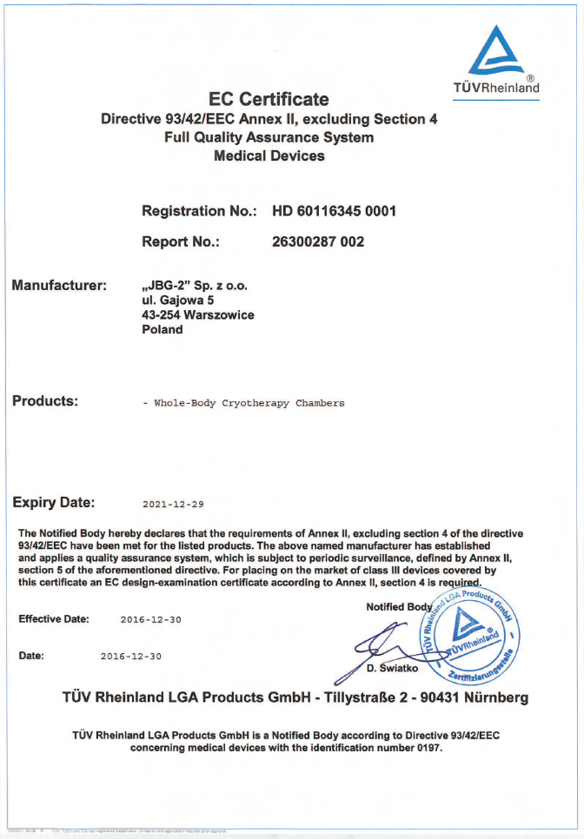
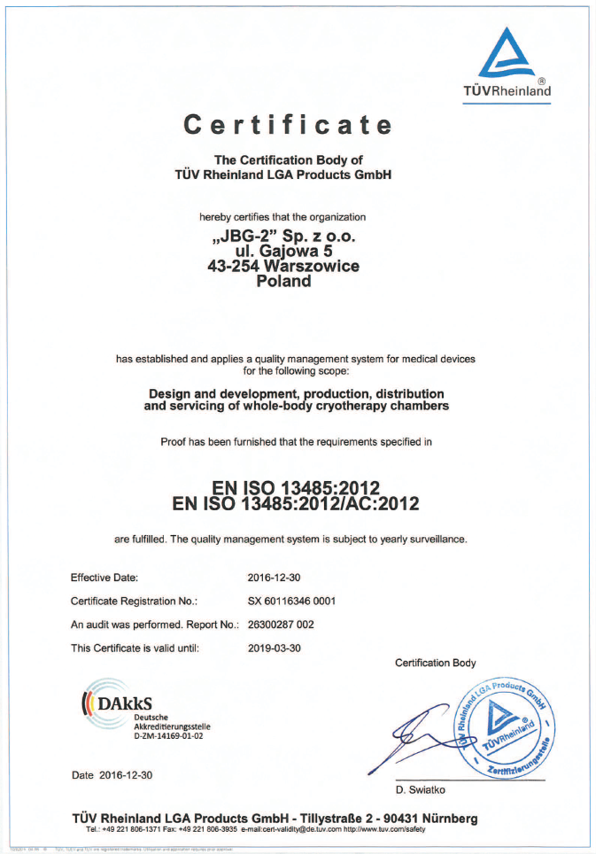
Medical certification

